Slide 1
New unit of maths is about position and direction. There are various important words to remember. They are the following; translation, rotation, reflection, quadrant and co-ordinates.
Click on the links below to learn more about position and direction. https://www.youtube.com/watch?v=VJTxv-tRKj0

Slide 2


Year 5 – Summer Block 3 – Position and Direction
Step 1: Position in the
First Quadrant
© Classroom Secrets Limited 2018

Slide 3
Watch the video below or go through the power point.
https://www.thenational.academy/year-5/maths/an-introduction-to-translation-year-5-wk1-1#slide-3

Slide 4
Introduction
10
9
8
7
6
5
4
3
2
1
0
Label the x axis.
Label the y axis.
What are the coordinates for A, B, C, D and E?
Does it matter which way round you write the numbers?
B
E
A
D
C
0 | 1 | 2 | 3 | 4 | 5 | 6 | 7 | 8 | 9 | 10
© Classroom Secrets Limited 2018

Slide 5
Introduction
10
9
8
7
6
5
4
3
2
1
0
Label the x axis.
Label the y axis.
What are the coordinates for A, B, C, D and E?
Does it matter which way round you write the numbers? Yes, as the x-axis must be recorded first.
(8, 9)
B
(6, 7)
E
y
(3, 5)
A
D
(2, 2)
C
(8, 1)
0 | 1 | 2 | 3 | 4 | 5 | 6 | 7 | 8 | 9 | 10
x
© Classroom Secrets Limited 2018

Slide 6
Varied Fluency 1
Write the coordinates of A, B, C, D and E.
y
10
9
8
7
6
5
4
3
2
1
0
C
B
A
E
D
x
0 | 1 | 2 | 3 | 4 | 5 | 6 | 7 | 8 | 9 | 10
© Classroom Secrets Limited 2018

Slide 7
Varied Fluency 1
Write the coordinates of A, B, C, D and E.
y
10
9
8
7
6
5
4
3
2
1
0
C
B
A
E
D
x
0 | 1 | 2 | 3 | 4 | 5 | 6 | 7 | 8 | 9 | 10
A (4, 3) B (8, 4) C (0, 8) D (10, 0) E (2, 2)
© Classroom Secrets Limited 2018

Slide 8
Varied Fluency 2
Each point moves two squares left.
Write the new coordinates of each point.
y
10
9
8
7
6
5
4
3
2
1
0
E
D
C
B
A
x
0 | 1 | 2 | 3 | 4 | 5 | 6 | 7 | 8 | 9 | 10
© Classroom Secrets Limited 2018

Slide 9
Varied Fluency 2
Each point moves two squares left.
Write the new coordinates of each point.
y
10
9
8
7
6
5
4
3
2
1
0
E
E
D
D
C
C
B
B
A
A
x
0 | 1 | 2 | 3 | 4 | 5 | 6 | 7 | 8 | 9 | 10
A (6, 0) B (1, 1) C (8, 5) D (0, 6) E (4, 8)
© Classroom Secrets Limited 2018

Slide 10
Varied Fluency 3
Look at the shape drawn on the grid below.
Write the coordinates of the vertices of the shape.
y
10
9
8
7
6
5
4
3
2
1
0
x
0 | 1 | 2 | 3 | 4 | 5 | 6 | 7 | 8 | 9 | 10
© Classroom Secrets Limited 2018

Slide 11
Varied Fluency 3
Look at the shape drawn on the grid below.
Write the coordinates of the vertices of the shape.
y
10
9
8
7
6
5
4
3
2
1
0
(3, 8)
(7, 8)
(3, 4)
(7, 4)
x
0 | 1 | 2 | 3 | 4 | 5 | 6 | 7 | 8 | 9 | 10
© Classroom Secrets Limited 2018

Slide 12
Problem Solving 1
The coordinates below will create a letter.
Draw and join them on the grid to find out the letter.
y
10
9
8
7
6
5
4
3
2
1
0
(3, 7) (5, 7) / (3, 3) (5, 3) / (4, 7) (4, 3)
Note: The / means it is the same letter but lift your pencil to start a new line.
x
0 | 1 | 2 | 3 | 4 | 5 | 6 | 7 | 8 | 9 | 10
© Classroom Secrets Limited 2018

Slide 13
Problem Solving 1
The coordinates below will create a letter.
Draw and join them on the grid to find out the letter.
y
10
9
8
7
6
5
4
3
2
1
0
(3, 7) (5, 7) / (3, 3) (5, 3) / (4, 7) (4, 3)
Note: The / means it is the same letter but lift your pencil to start a new line.
x
0 | 1 | 2 | 3 | 4 | 5 | 6 | 7 | 8 | 9 | 10
© Classroom Secrets Limited 2018

Slide 14
Problem Solving 2
Two coordinates out of four have already been plotted. Write their coordinates and the missing ones that are needed on the grid to create a square.
y
10
9
8
7
6
5
4
3
2
1
0
x
0 | 1 | 2 | 3 | 4 | 5 | 6 | 7 | 8 | 9 | 10
© Classroom Secrets Limited 2018

Slide 15
Problem Solving 2
Two coordinates out of four have already been plotted. Write their coordinates and the missing ones that are needed on the grid to create a square.
y
10
9
8
7
6
5
4
3
2
1
0
(4, 7)
(8, 7)
(4, 3)
(8, 3)
x
0 | 1 | 2 | 3 | 4 | 5 | 6 | 7 | 8 | 9 | 10
© Classroom Secrets Limited 2018

Slide 16
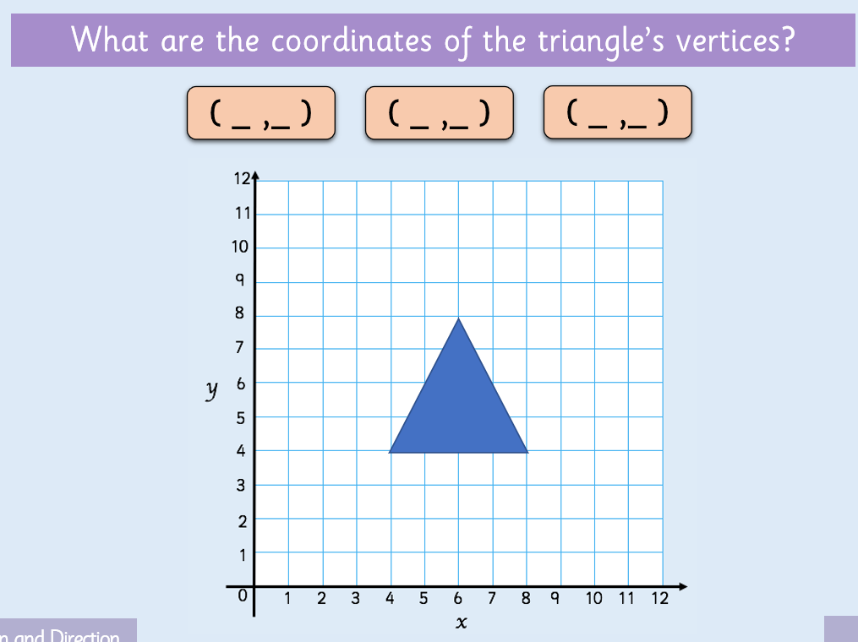
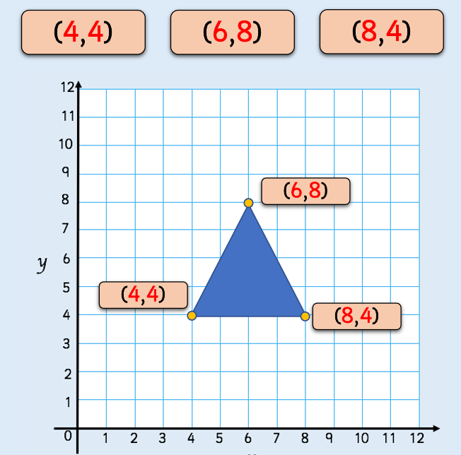
Move box to reveal the answer.

Slide 17

Reasoning 1
True or false?
Explain your answer.
You need to plot the y axis first.
© Classroom Secrets Limited 2018

Slide 18
Reasoning 1
True or false?
Explain your answer.
False because…
You need to plot the y axis first.
© Classroom Secrets Limited 2018

Slide 19
Reasoning 1
True or false?
Explain your answer.
False because the x axis comes first then the y axis (along the corridor up the stairs/walk before you climb).
You need to plot the y axis first.
© Classroom Secrets Limited 2018

Slide 20
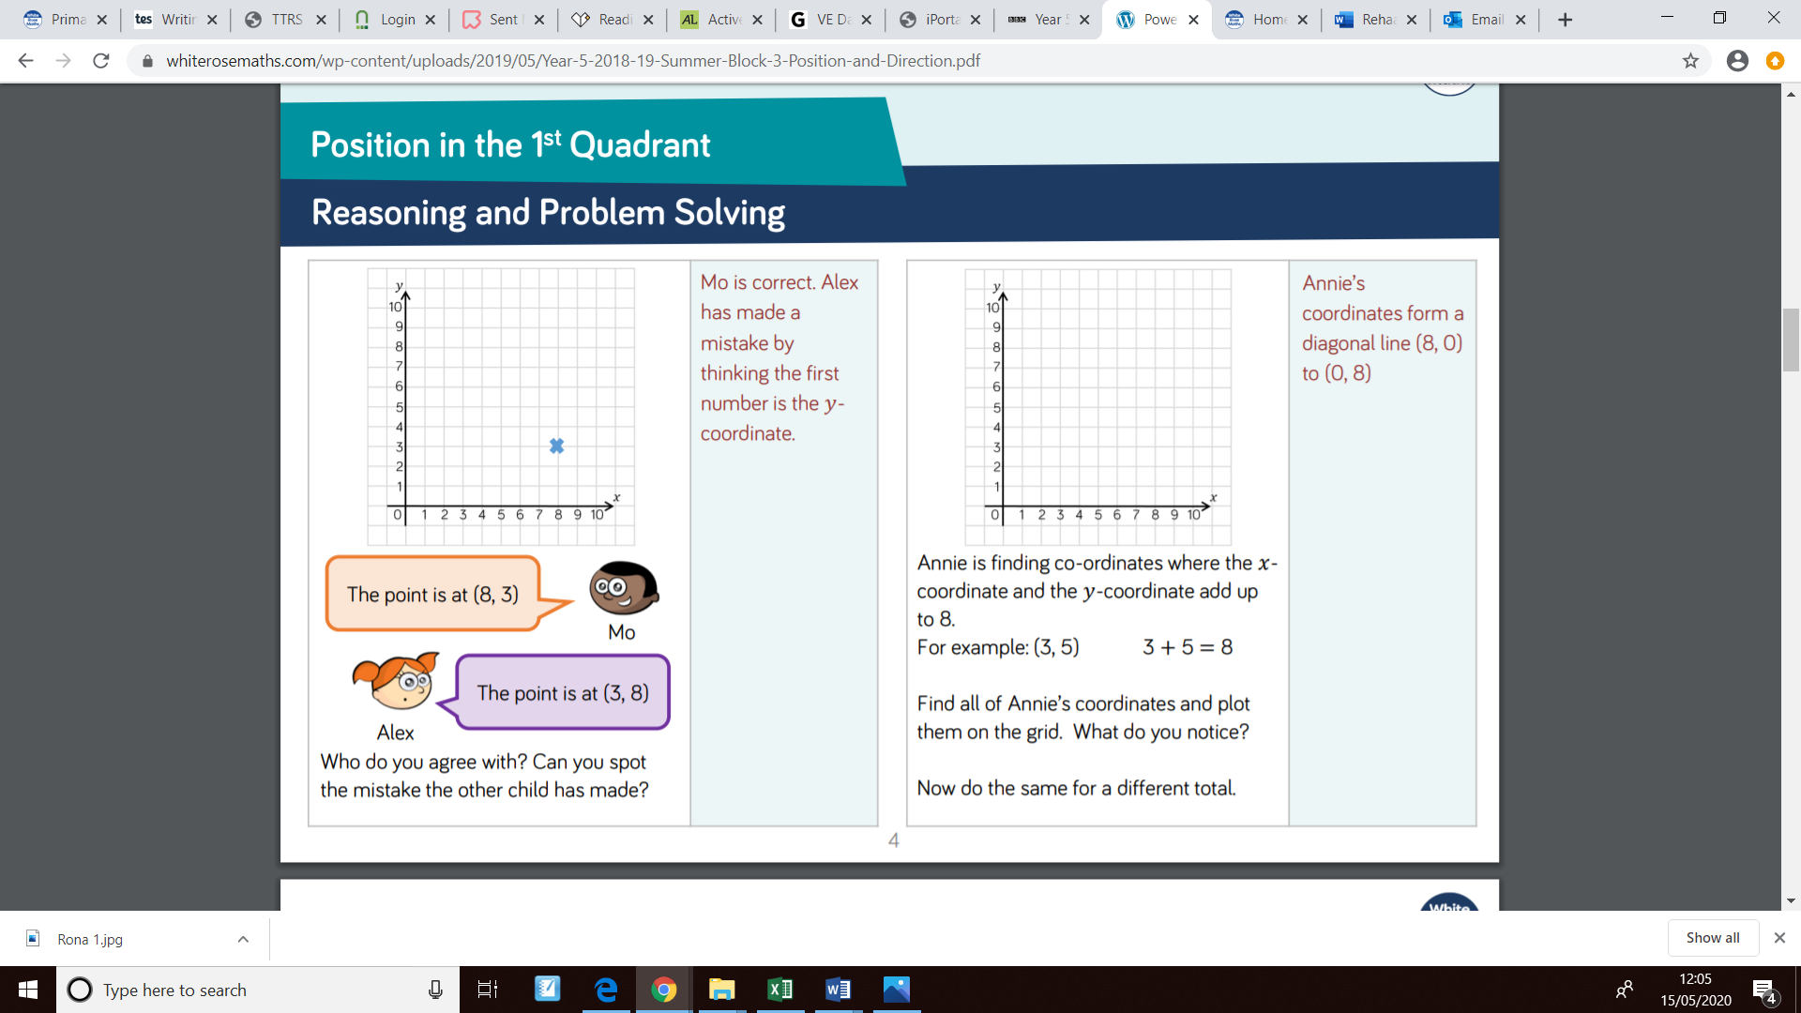
Move the box to reveal the answer.
Move the box to reveal the answer.

Slide 21
Follow the link to play the game. https://www.teacherled.com/iresources/coordinates/showthecoordinate

