Slide 1
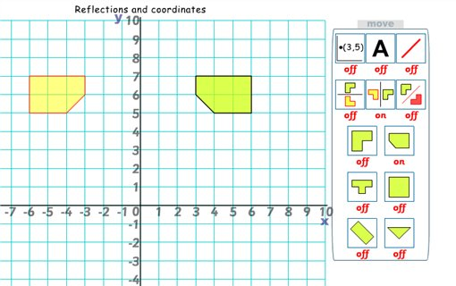
Reflection with co-ordinates
Lesson 3

Slide 2
https://www.thenational.academy/year-5/maths/to-describe-reflections-using-coordinates-year-5-wk2-2#slide-3

Slide 3
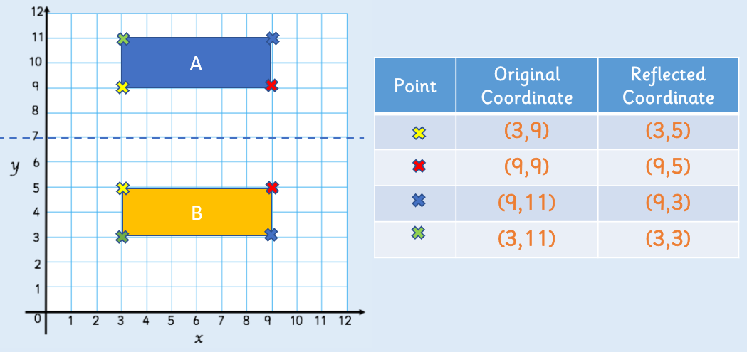
Have a look at the image below to familiarise yourself with reflection using co-ordinates. Notice how reflection is different to translation. Look at the new co-ordinates compared to the co-ordinates from shape A. Notice the colour of the X’s (vertex) from position A to B.

Slide 4
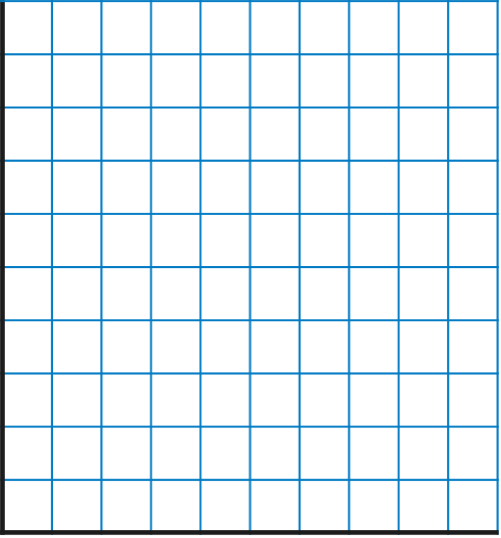
Reflection with Coordinates
You could focus on one vertex at a time, counting the distance from the mirror line and repeating this distance across the mirror line, plotting the points as you go to show the reflected shape.
You could focus on one vertex at a time, counting the distance from the mirror line and repeating this distance across the mirror line, plotting the points as you go to show the reflected shape.
How could you reflect the shape if you didn’t have a mirror to hand?
Discuss with your Learning Partner.
10
9
8
7
6
5
4
3
2
1
0
0
0
1
2
3
4
5
6
7
8
9
10

Slide 5
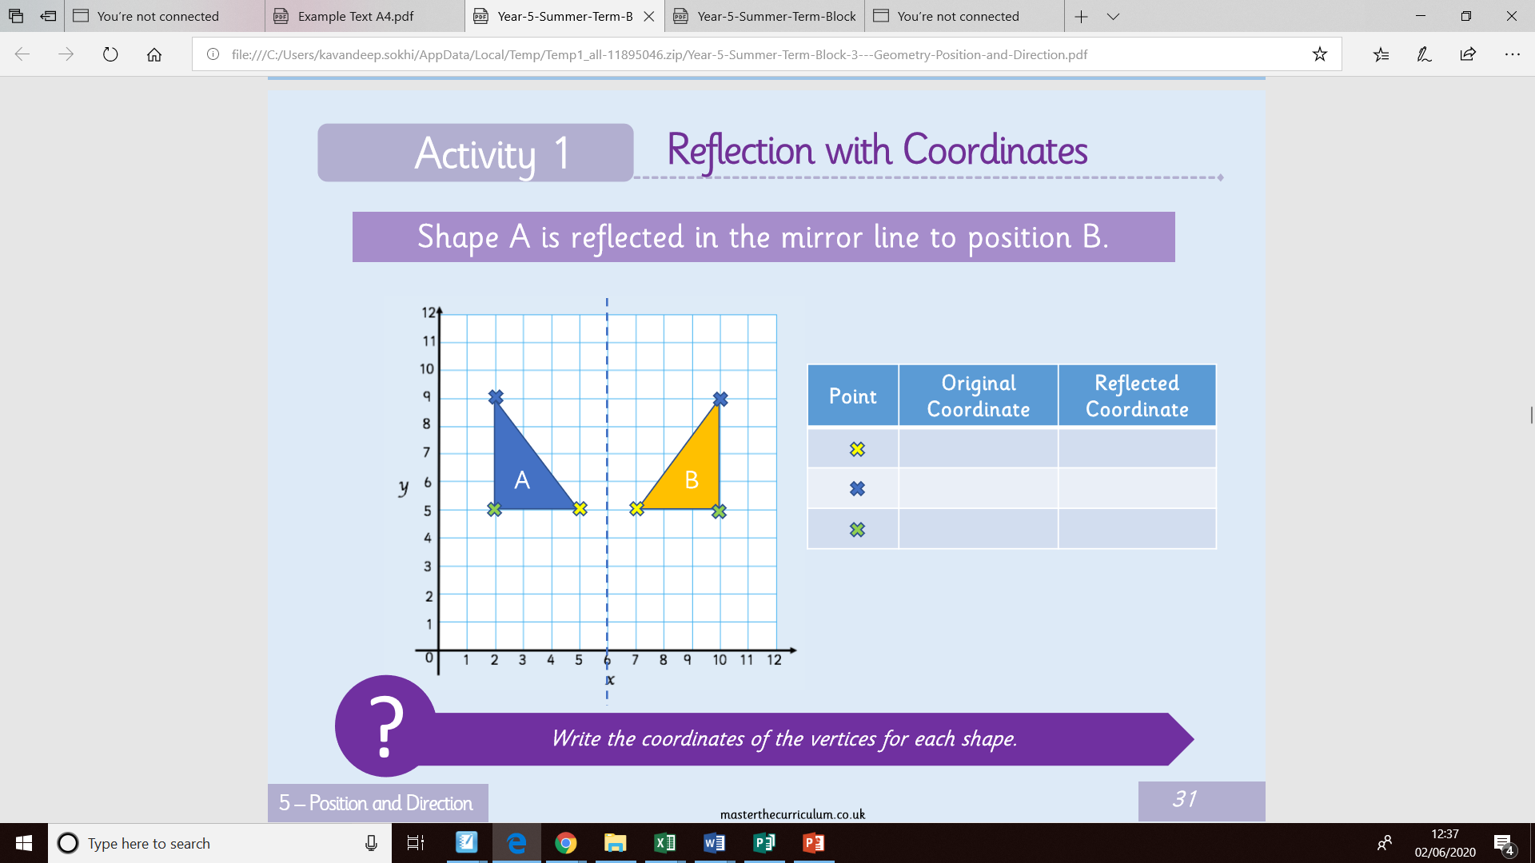
Shape A has been reflected. Once a shape has been reflected it is known as the image. Therefore, shape B is called the image. Can you complete the table below. First one has been done for you. Once you have completed the table, you can check your answers on the next slide.
Bronze
(5, 5)
(7, 5)

Slide 6
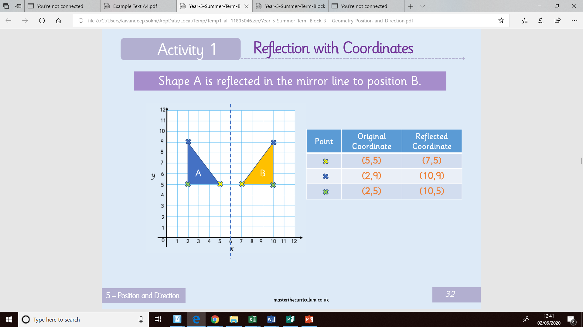
Bronze

Slide 7
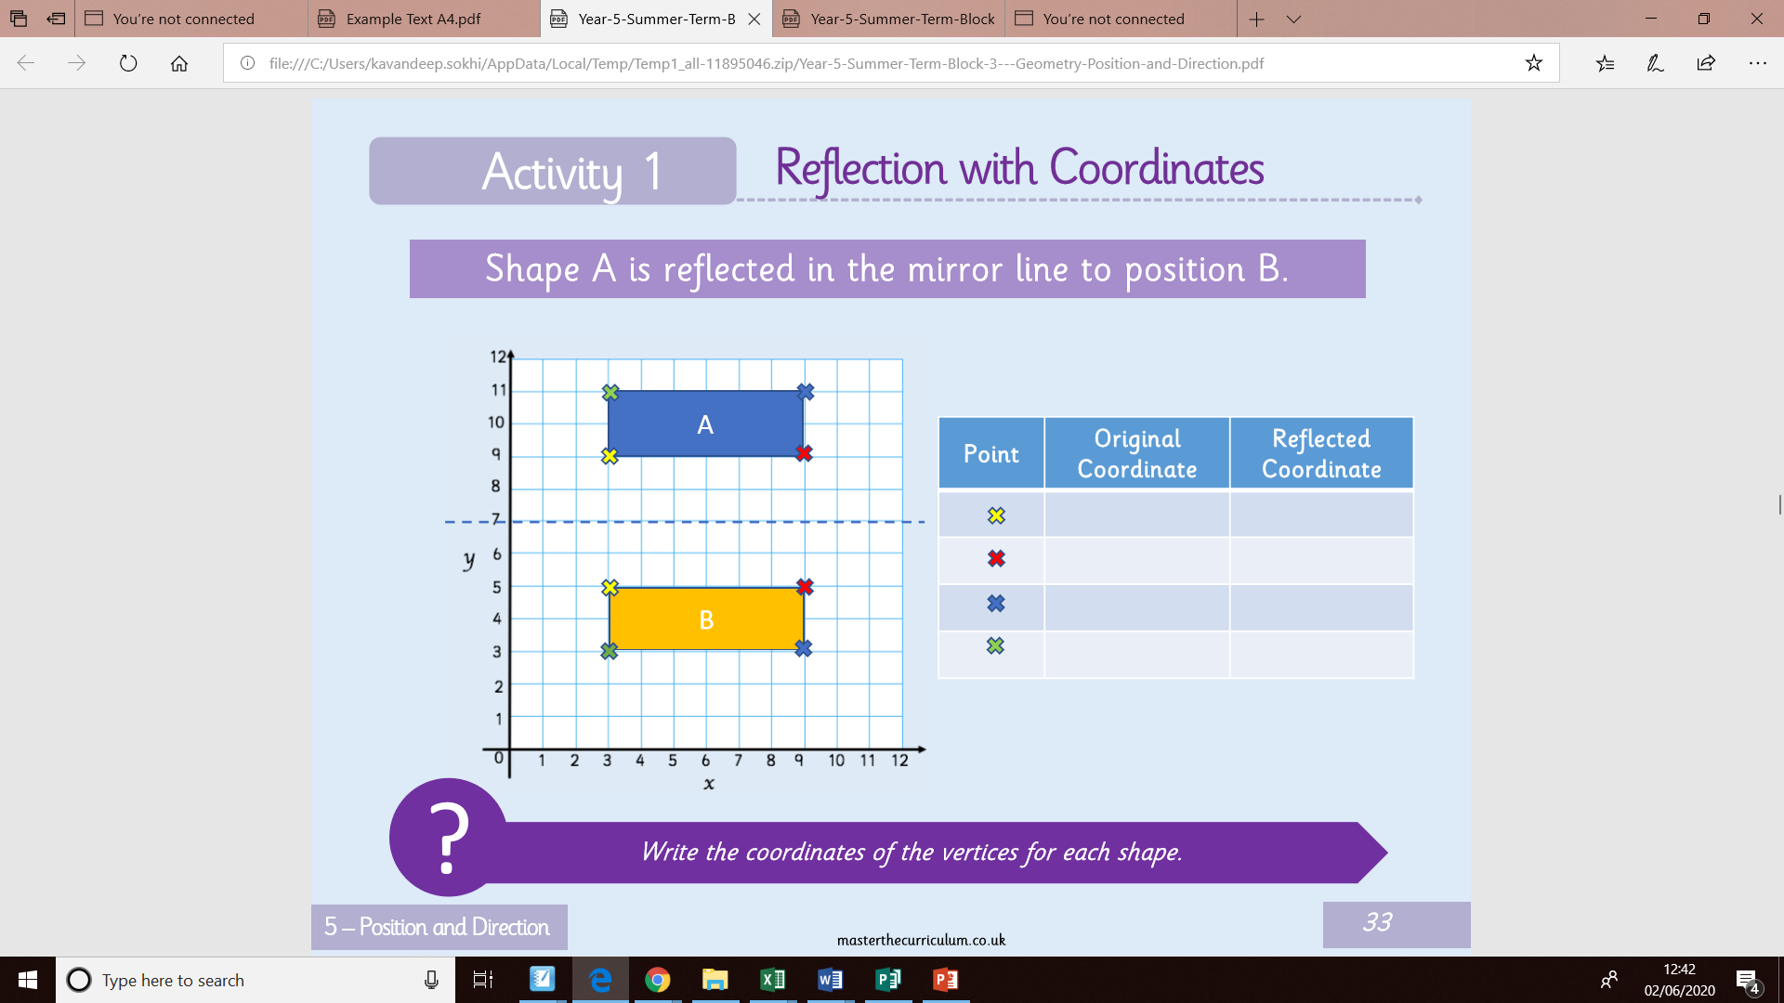
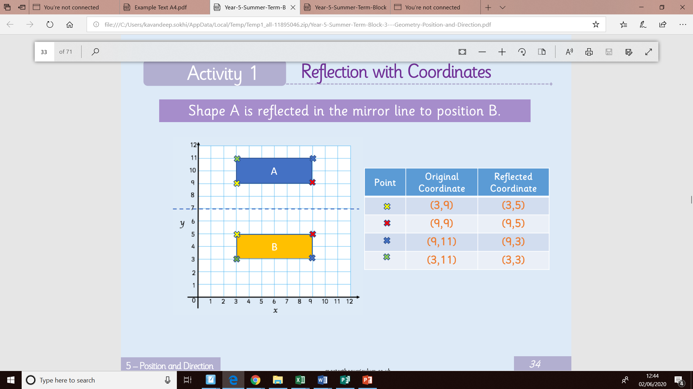
Shape A has been reflected. Can you complete the table below. Once you have completed the table, you can check your answers by moving the blue box.
Bronze
Move box to reveal answers.

Slide 8
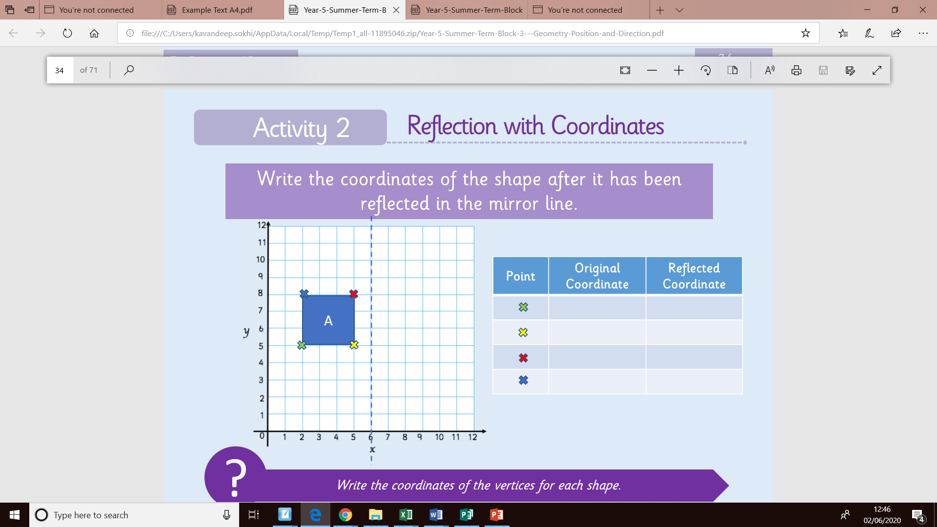
In this activity you must reflect shape A and write the new co-ordinates in the table below. Remember to count the squares in order to have the exact same measurements from rectangle A. Use the mirror line to help you. Once completed, check your answers onto the next slide.
Silver

Slide 9
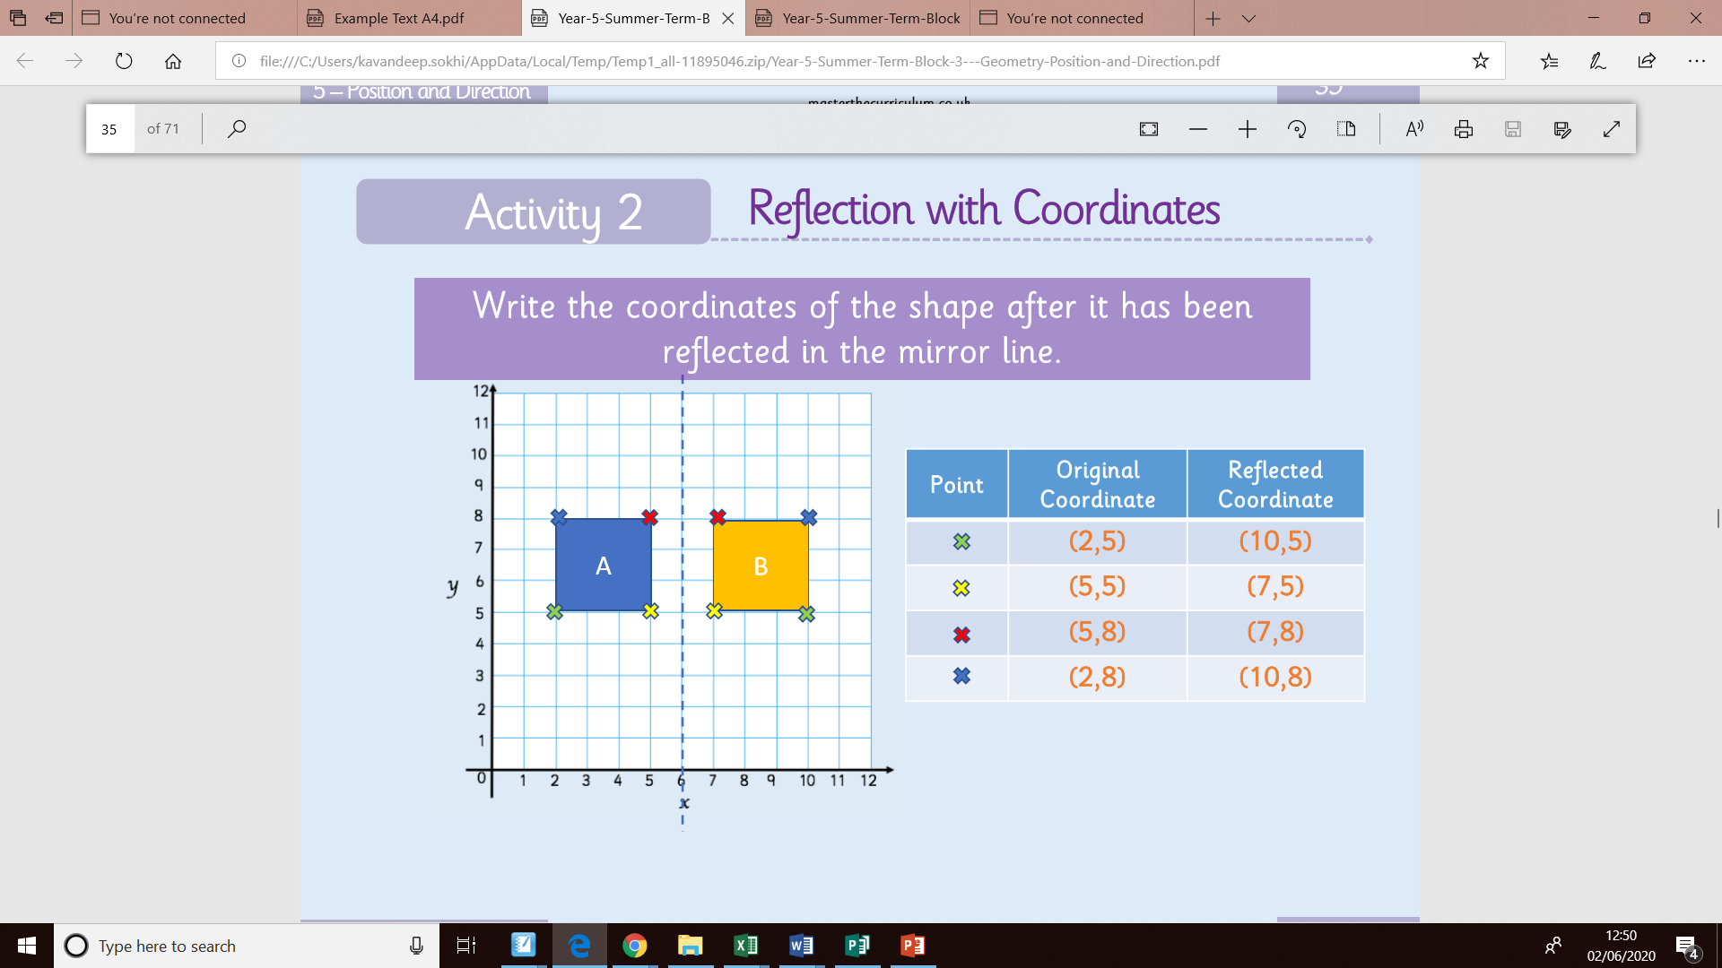
Silver

Slide 10
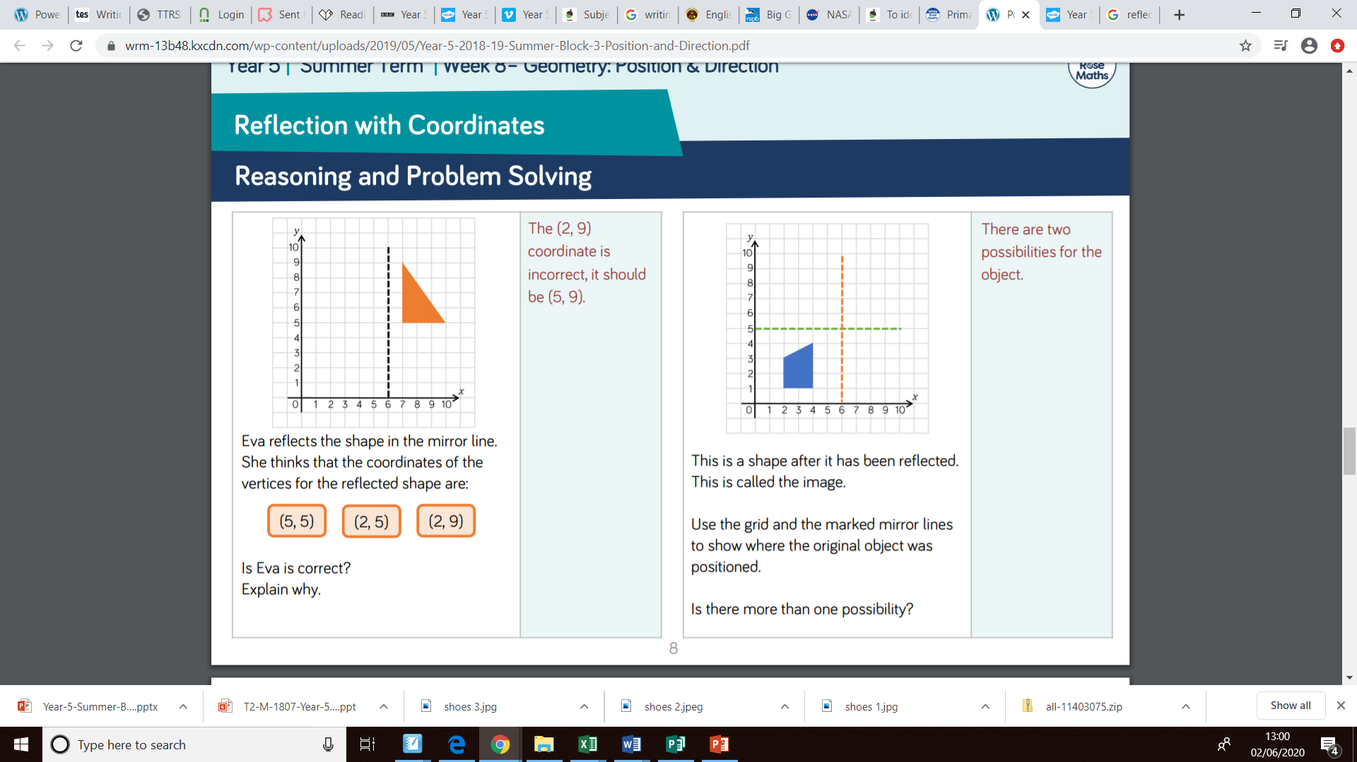
Gold
Move box to reveal answers.

