Slide 1
Translation using co-ordinates.
Lesson 5

Slide 2
Watch the videos below to understand how to translate using co-ordinates.
http://www.emaths.co.uk/images/tutorials/translation/Translation/Presentation_Files/index.html
https://www.thenational.academy/year-5/maths/describe-position-after-translation-year-5-wk1-4#slide-3
https://www.thenational.academy/year-5/maths/describe-position-after-translation-year-5-wk1-5#slide-3

Slide 3
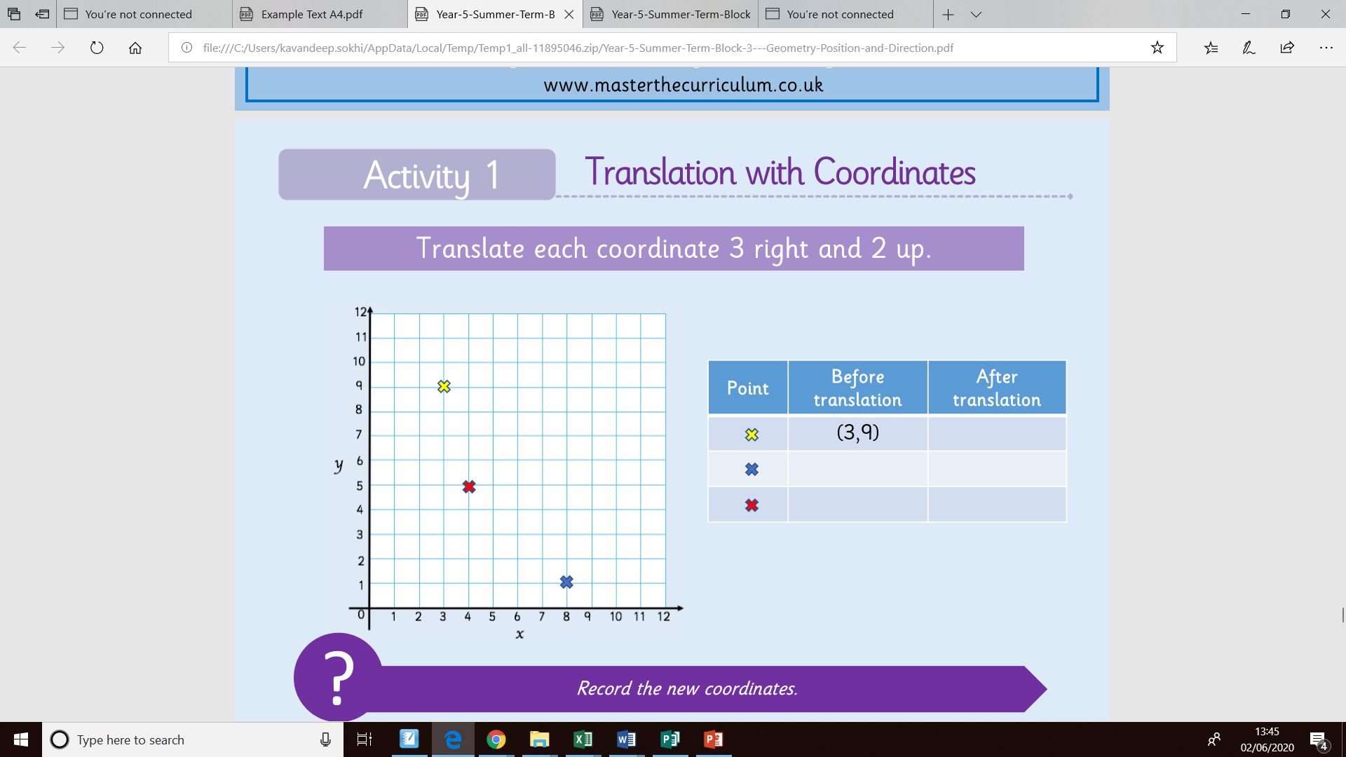
Translate each co-ordinate 3 right and 2 up. Fill in the chart. The first one has been done for you. Once you have completed the chart you can find the answers on the next slide.
(6, 11)

Slide 4
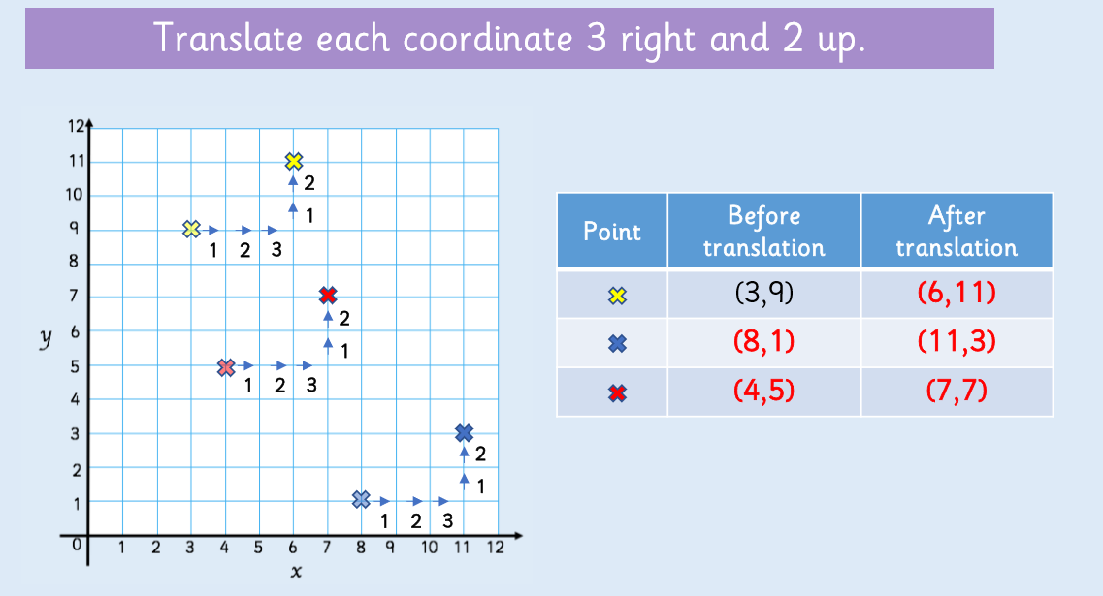

Slide 5
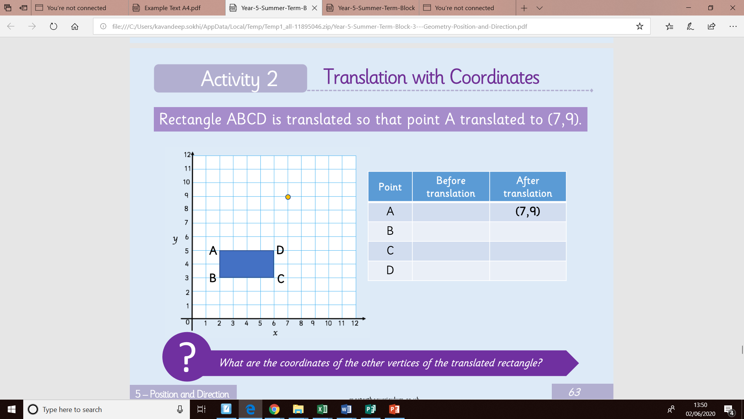

Slide 6
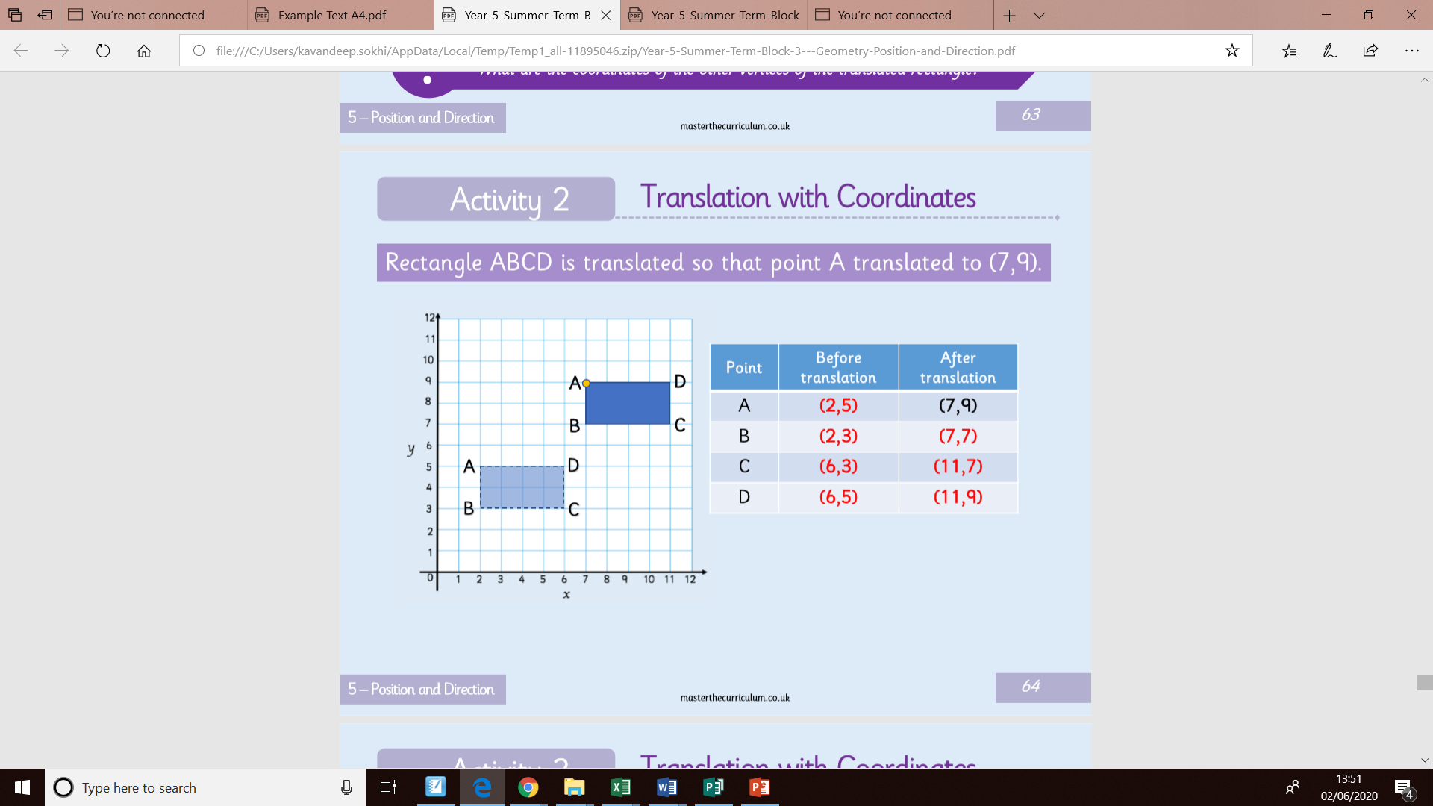

Slide 7
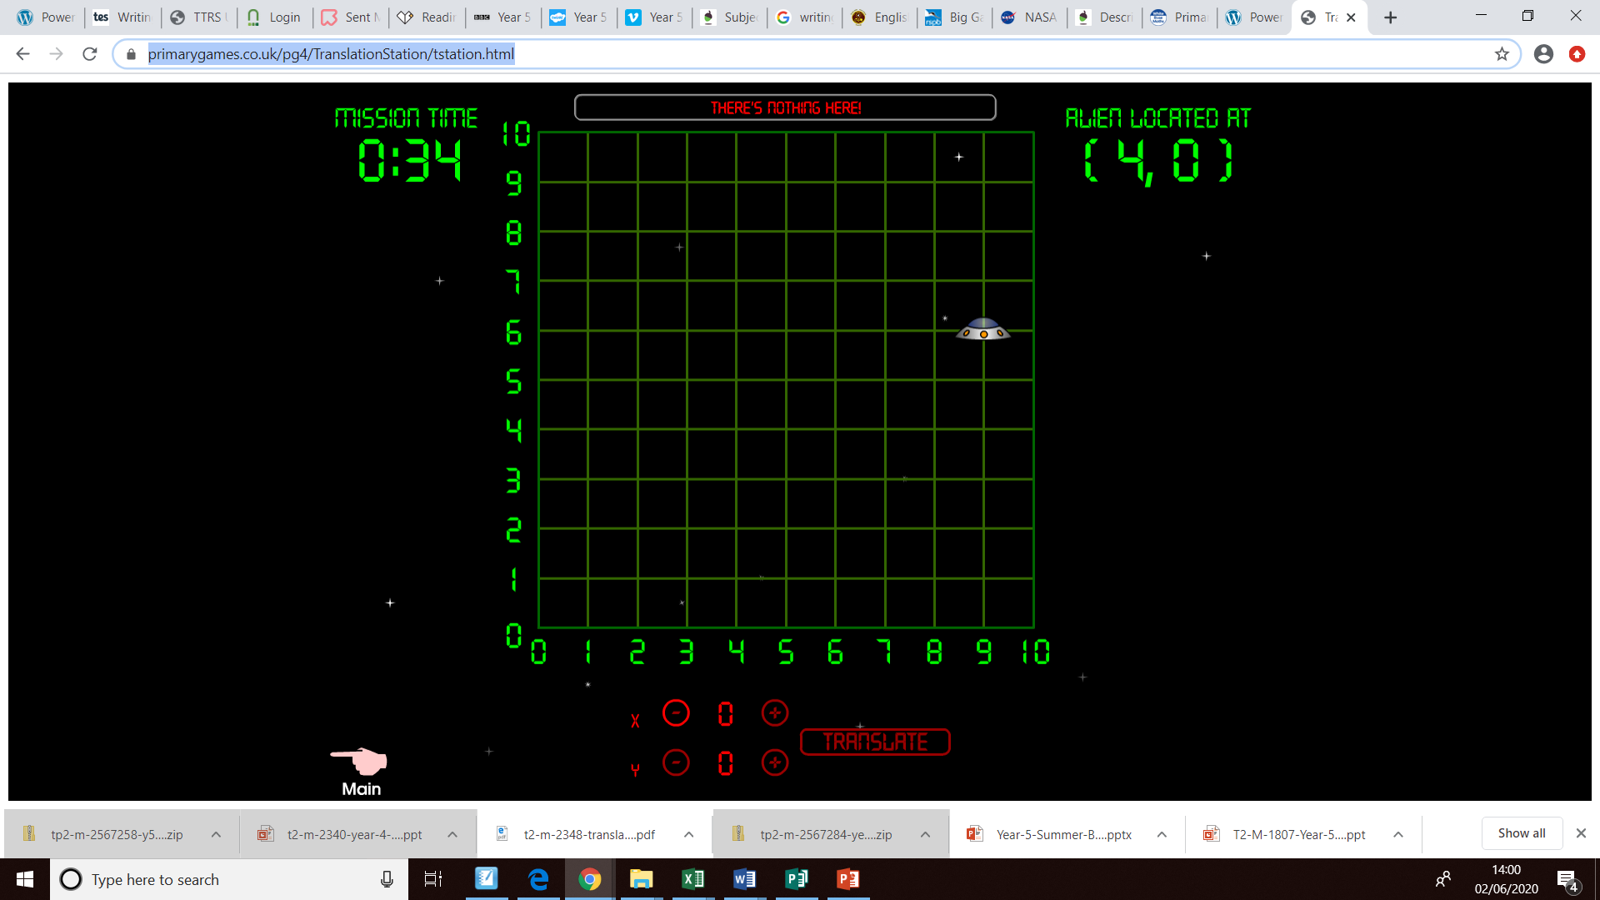
Interactive translation game.
https://www.primarygames.co.uk/pg4/TranslationStation/tstation.html
Instructions
Coordinates given.
Click on the – or + button to translate coordinates.

