Slide 1

Welcome parents
Y6 Meet the teacher meeting
Tuesday 17th September 2024

Slide 2
Meet the teachers
Class teachers:
6G – Miss Geddes
6T – Mr Tayor
Classroom support :
Mrs Fellows

Slide 3
Welcome to Year 6
The School day
The Curriculum
Homework
Uniform
P.E
Helpful information
Behaviour
What you can do?

Slide 4
The School Day
8:35: Morning task / Registration
8:55: Collective worship
9:20: Lesson 1
10:30: Break Time
10:45 Lesson 2
11:45 Lesson 3
12.30: Lunch Time
1:30: Lesson 4
2:30: Lesson 5
3.00:Class read
3:15: Home Time

Slide 5
Year 6 Curriculum
Maths - White Rose
Place value Addition Subtraction Multiplication Division Fractions Converting units | Decimals Percentages Ratio Algebra Area, Perimeter, Volume Statistics | Geometry Properties of shapes Position and Direction
English - The Write Stuff
Narratives Character descriptions Diary entries Non chronological reports Setting descriptions Formal letter (persuasion) Balanced arguments Newspaper Articles
Science – National Curriculum
Living things and their habitats | Animals including Plants and living things–Life cycle humans | Electricity | Light |  | Evolution
History, Geography, Religious Education. Computing, PE, RHSE, Art, D&T, Commando Joes and Music

Slide 6



Homework
Our focus is still spellings and reading.
Spellings will be given out every Monday and they will tested every Friday.
Please read as much as you can with your children at home. Asking them lots of questions about what they have read to check their understanding.
Other online homework…

Slide 7
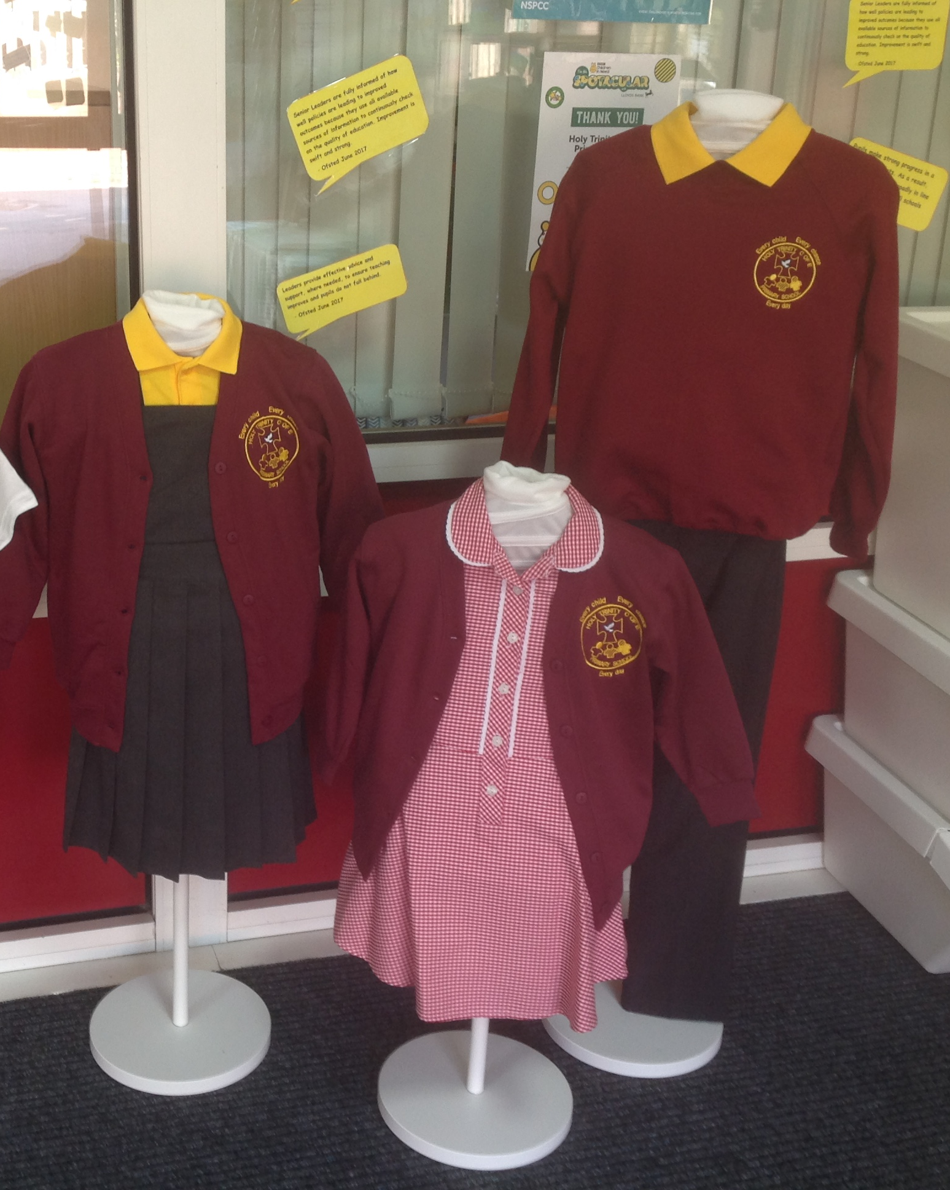
School Uniform:
Boys:
Grey / black trousers or shorts
Gold polo shirt
Burgundy jumper
Black shoes
Plain black or white socks
Girls:
Grey / black trousers or skirt or shorts
Gold polo shirt
Burgundy jumper
Summer dress
Black shoes
Plain black or white socks
School colours for hair accessories
Studded earrings
Long hair tied back

Slide 8
PE KIT
Black joggers or leggings
Gold t shirt
Burgundy jumper
Black trainers
Plain white or black socks
Hair tied back
PE is on a Friday.
Children will come to school in their PE kit on Fridays.
No jewellery please.

Slide 9
Good behaviour
We continue to follow the “Good to be Green” approach with our behaviour management.
Non-verbal warning
Verbal warning- blue stop and think card-
Yellow card (miss 5 mins play)
Red card (miss 15 mins play)
Behaviour recovery (Senior leaders office)
Praise Assembly
Praise Assembly will take place on Wednesday mornings. If your child has been selected for praise you will receive an invitation to join us in celebrating your child’s achievements at 8:50 am.

Slide 10
Toast
Snacks
Children can bring a piece of fruit or a healthy alternative for their snack at Playtime if they wish to.
Water bottles
Children need to bring in their own water bottle which they should bring into school everyday.
Children are welcome to have toast each week at a cost of 50p however this needs to be paid online (Gateway).
This needs to be paid half-termly.
Children can also have milk at break times which also needs to be paid online.

Slide 11
SATS
END OF THE YEAR PLANS
In 2025, SATs will take place between Monday 12th May 2025 to Thursday 15th May 2025
SPaG and Spelling
Reading
Arithmetic, Reasoning x2
Prom
Graduation
Reward Day
Production

Slide 12
REMINDER
George Salter Academy | Tuesday 17th September. | Open evening | TBC – check website.
Holly Lodge High School | Thursday 26th September Friday 27th September | Open evening Open day | 5:00 – 7:00pm 9:30 – 11:00am (appointment only)
Sandwell Academy | Thursday 19 September Tuesday 8 October 2024 | Open evening Open evening | 4:00 - 7:00pm 4:00 - 7:00pm
Shireland Biomedical University Technical College | Tuesday 17th September 2024 | Open evening | 4:00pm – 7:00pm
Shireland Collegiate Birmingham Symphony Orchestra Academy | Wednesday 18th September Thursday 19th and Friday 20th September Saturday 21st September | Open evening Open morning Open morning | TBC – check website. By appointment only TBC – check website.
Shireland Collegiate Academy | Tuesday 17th September | Open evening | TBC – check website.
Parents- deadline for high school application is on October 31st 2024
Please check when open evenings are for high schools:
West Bromwich Collegiate Academy | 12th September 2024 16th - 20th September | Open evening Open mornings | 4:30 - 8pm Bookable timeslots

Slide 13
What you can do to help at home?
Listen to your child read
Ensure that your child completes their homework
Practise spellings and times tables.
Ensure your child is in school everyday and on time.
Talk to your child about their learning.

Slide 14
Any Questions ?

