Slide 1
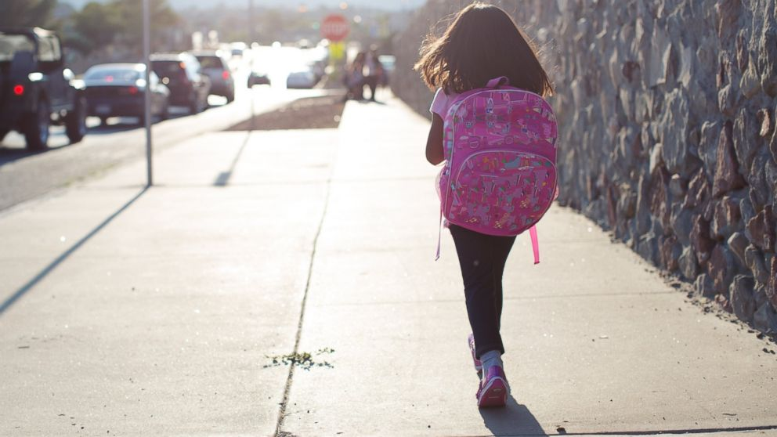
Home time Prayers

Slide 2
Father God we love you,
And thank you for our day.
Thank you for our teachers,
Our learning and our play.
We're sorry for the wrong we’ve done,
Help us to put it right.
Please keep us safe on journeys home,
And bless us through the night.
Amen

Slide 3
Father in Heaven I come to say
Thank you for your love today.
Thank you for my family
And all the friends you give to me.
Guard me in the dark of night
And in the morning send your light.
Amen

Slide 4
Thank you lord for this good day.
Bless our friends, our work, our play.
Amen

Slide 5
Lord Jesus, we praise you because you are ….
Lord Jesus, we are sorry because we have….
Lord Jesus, we thank you for ….
Lord Jesus, we ask you to help ….
Lord Jesus, we pray that you would be with us on our journeys home and bring us back to school safely tomorrow.
Amen
(Leave a space for children to think of their own response at end of each line, or ask particular children to fill in blanks)

Slide 6
Dear Lord,
We praise you for a good, good day.
Lord, we’re sorry when we’ve gone astray
Lord, we thank you for your love that’s true
Help us to bless others in all we do.
Amen

