Slide 1


Slide 2
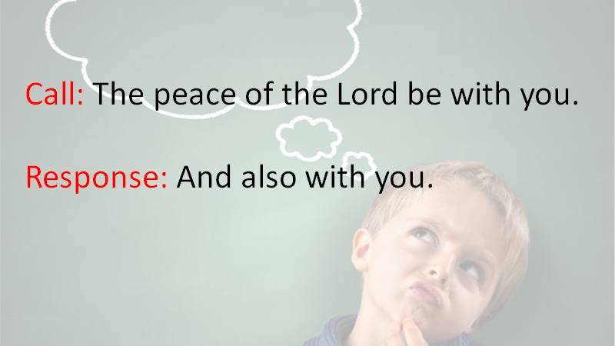

Slide 3


Slide 4
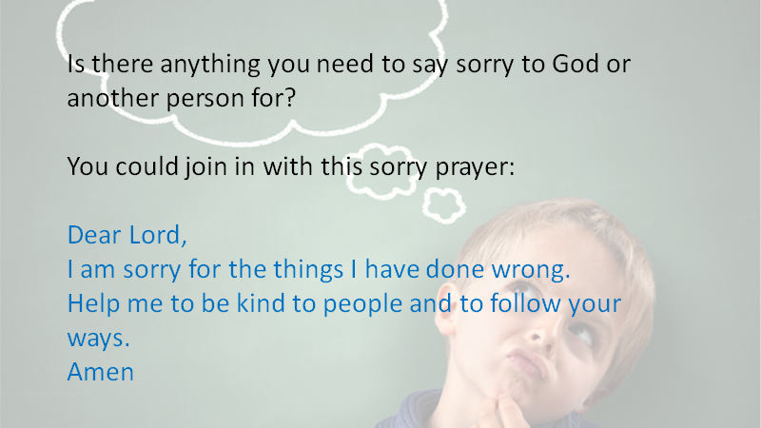

Slide 5
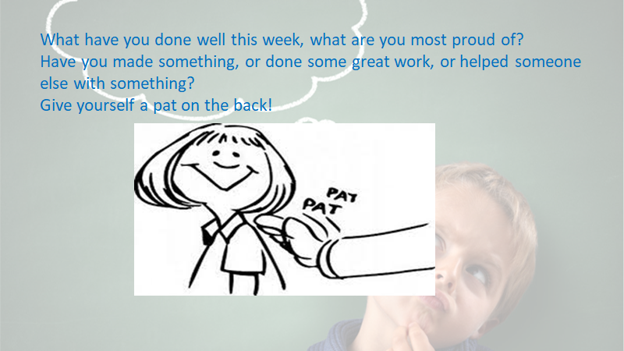

Slide 6
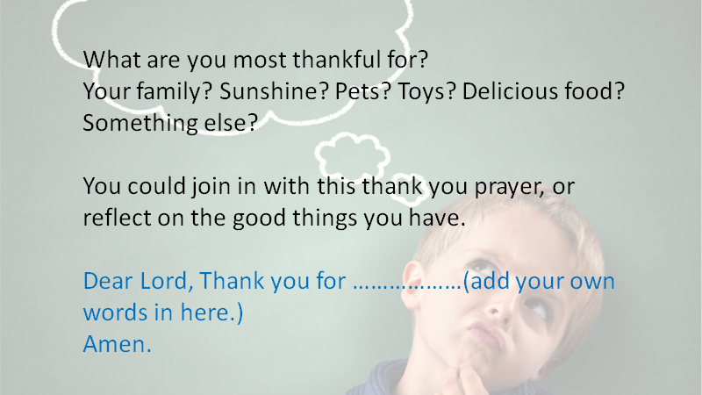

Slide 7


Slide 8
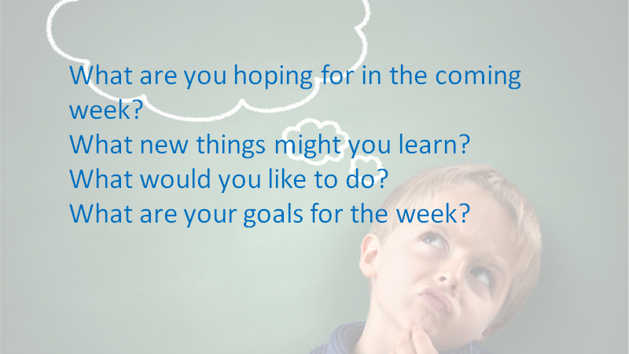

Slide 9
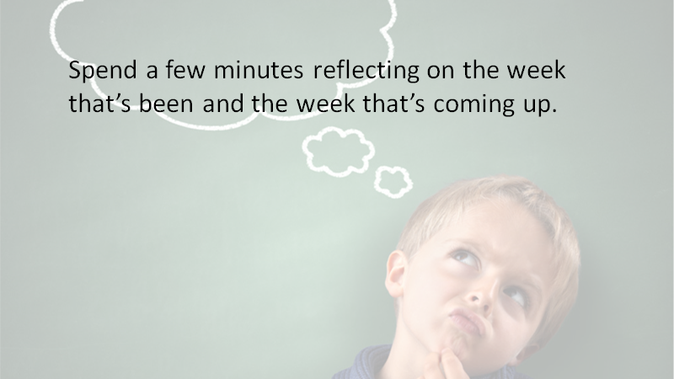
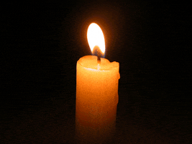

Slide 10

You could join in with this prayer if you would like to:
Dear Lord,
We thank you for all that we have done, and all that we have enjoyed this week. Thank you for giving us the ability to achieve and do new things.
We pray that in this coming week we would walk closely with you and enjoy all the good things you have for us.
Amen

Slide 11


