Slide 1

Welcome to Year 1

Slide 2
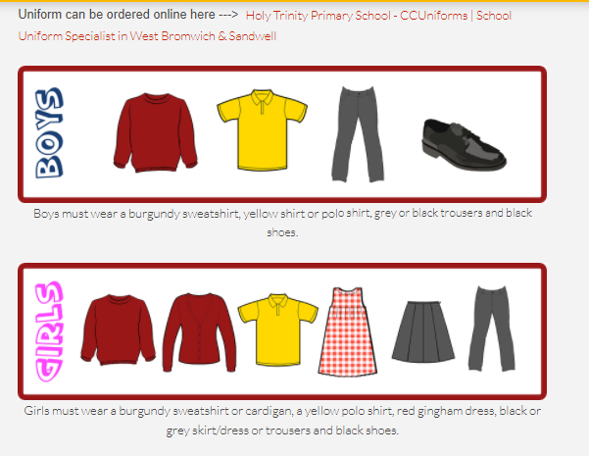
Year 1 Expectations – Uniform.
Children must wear the correct uniform. Ensure this includes black shoes (not trainers).

Slide 3
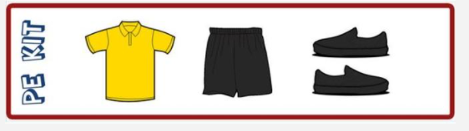
Year 1 Expectations – Uniform.
Children will be coming into school wearing their P.E kits. This includes a yellow t-shirt, leggings/ joggers and a grey or black hoodie without a logo. P.E is every Tuesday for both classes.
Children often try to bend the rules when it comes to uniform!
Please do not allow children to come to school in denim jeans or combat trousers, in T– Shirts with unsuitable logos or in vest tops. Football kits/tops are not suitable PE kit, please do not send your children to school in these on PE days. Please do not allow girls to come to school in high heeled shoes or strappy sandals as these are not practical and can cause accidents.
Please put your child's name in all clothing!

Slide 4
Year 1 Expectations – Behaviour.
We believe that the Christian Values we promote contribute positively to behaviour within our school and helps pupils develop the skills needed to become fantastic role models both in school and the community.
We promote the following Christian Values: Responsibility, Friendship, Caring, Consideration, Respect, Honesty, Peace and Forgiveness.

Slide 5
Year 1 Expectations – Rewards
Halos
Attendance – your child will receive 2 halos a week if your child attends school every day and on time.
Praise assembly
Termly Achievers assembly
*All policies are on our school website.

Slide 6
Year 1 Expectations – Rewards and Sanctions.
We explain to the children that it is ‘Good to be Green’.
Blue card: Non-verbal warning (Stop and think)
Yellow card – 5 minutes of playtime will be lost.
Red card – playtime will be spent with a member of staff.
Bottom liners - Behaviour Recovery – Head teacher and parents informed.
Every day all children start from Green!
*All policies are on our school website.

Slide 7

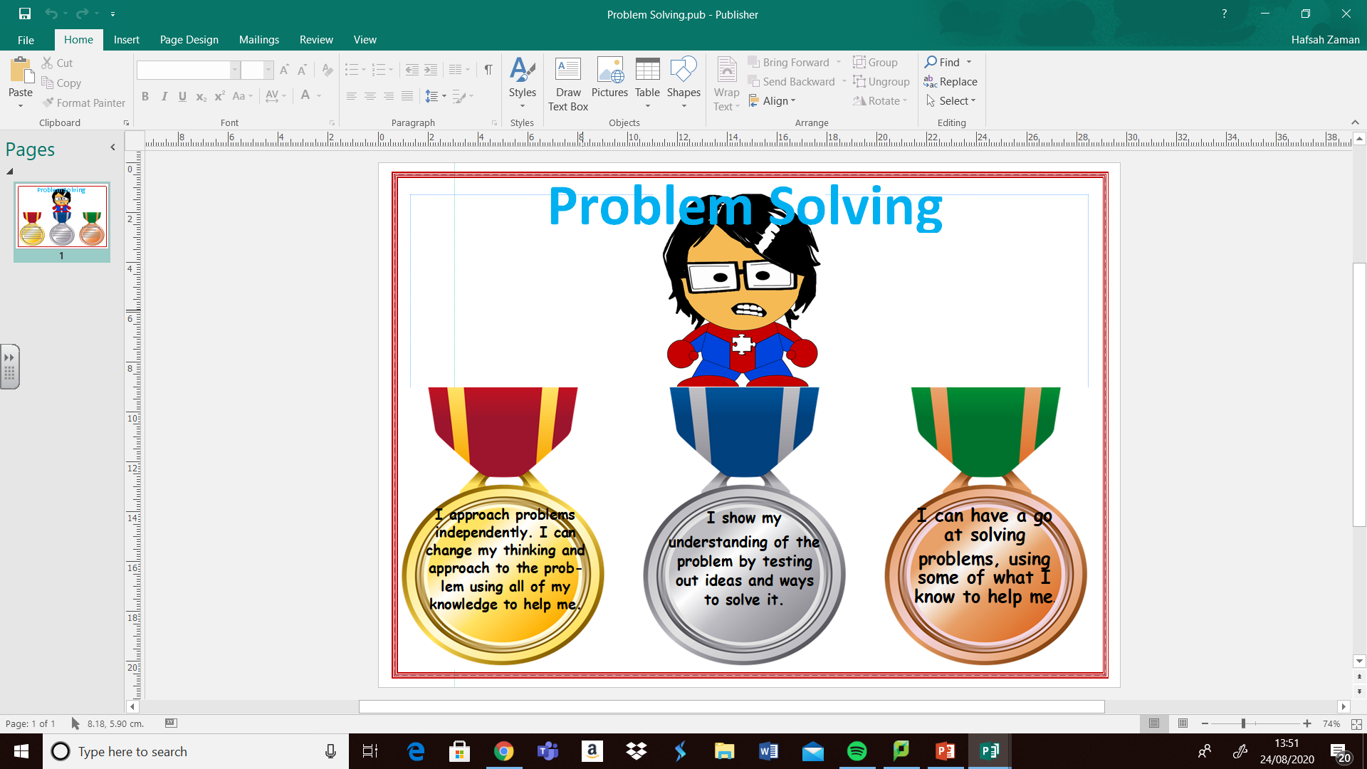

Year 1 Expectations – Learning Behaviour.
We believe that the Christian Values we promote contribute positively to behaviour within our school and helps pupils develop the skills needed to become fantastic role models both in school and the community.
We build on the learning behaviours in EYFS of cooperation, inquisitiveness and independence.
The learning behaviours we encourage the children to develop in KS1 are:

Slide 8
Settling into Year 1.
The children are doing really well!
Up until half term the children will follow a semi- formal timetable (Similar to Reception).
As the children gain more skills we raise the expectations and they will all be sitting at tables to follow lessons just like all the other children (Yr2 upwards).

Slide 9
Learning - Maths
  Our maths topic for this half term is: Place Value to 10.
  To count to 10 forwards and backwards beginning with 0 or 1, or from any given number.
  To count, read and write numbers to 10 in numerals and words.
  Identify and represent numbers using objects and pictorial representations including the number line, and use the languages of: equal to, more than, less than, fewer, most, least.
  Given a number identify one more and one less.
  Addition and subtraction within 10.
  Next half term we will move onto place value to 20.

Slide 10
Learning - English
  In English this half term, we will follow the ‘Talk for Writing’ Programme. We will be focusing our English Learning around the text “The Three Little Pigs”. Throughout all of our writing this term our main focuses are:
  Using sounds to spell words
  Holding a sentence (coming up with an idea and remembering it)
  Spelling of Common exception words
  Correct letter formation
  Capital letters at the beginning of sentences names and places.
  Finger spaces – leaving spaces between words.
  Full stops
  All of the above are compulsory if your child is to meet age related expectations.

Slide 11
Learning – Handwriting and presentation.
We use the Nelson handwriting scheme in school. This involves the children forming letters, starting from the correct point and also making the correct movements to form the letters.
Name writing
Please use a capital letter for the first letter and then lower case for all other letter.
We will provide you an information guide that will show you how we teach the children. Please support us in this as once the children learn to form letters in a particular way it is very difficult to correct this.
https://home.oxfordowl.co.uk/english/primary-handwriting/handwriting-year-1-age-5-6/

Slide 12


Slide 13
Snacks
Children are welcome to have toast each week at a cost of 50p however this needs to be paid online by at the beginning of each half term on the School Gateway.
Children can also have milk at break times which also needs to be paid online via COOL MILK.
Children will receive a piece of fruit at snack time and do not need to bring a snack into school.
We are a ‘Healthy School’ so please ensure only put water in their water bottles.
We are also a nut-free school so please do not send these in packed lunches (that also includes things that contain nuts).

Slide 14
Homework
  1. Reading focus across the school but especially in Year 1.
  Book bags with reading books need to be brought into school everyday so we can hear them read regularly.
  Children’s books will be changed and sent home on Friday..
  2. CEW’s (Common Exception words)
  Practise reading Reception and Year 1 Common Exception words.
  There is a sheet of words in their book bags.
  In addition to this soon the children will receive 2 books in their book bags. One of the books will also have CEW’s words in them to practice.

Slide 15
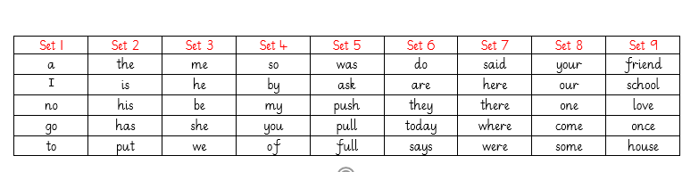
Year 1 Common exception words.

Slide 16


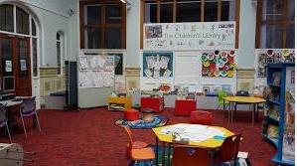
Additional Homework
  BUG CLUB logins
  We teach Phonics through this online platform and you also have access to this at home.
  Local Library
  Please take them to the library. It is free to join and the children can also take part in so many fun educational activities at the Library too!

Slide 17
Assessment – Phonics and Reading.
Phonics Screening in June – Every Year 1 child in this country does this assessment and we are working on it now and we need your support with this.
Children will be tested on words containing up to phase 5 sounds.
We have a Password of the Day on the door (CEW’s) this will help the children learn them.
Phonics Tracking
Common exception words – reading and spelling

Slide 18
Other Assessments
WellComm – Spoken English and comprehension
Salfords – Reading and comprehension
Reading, Writing and Maths assessments (NFER)
Pre and post assessments are carried out at the start and end of each new learning journey in all subjects.

Slide 19
Trips and visitors.
We will planning a trip for the children every term. The trips will relate to their learning that term. The trips and visitors are an invaluable opportunity to help the children learn.
We may ask you to volunteer!

Slide 20
Online Learning platforms
1. Active Learn: Bug club
2. Classroom secrets

Slide 21
Contact details:
anita.chander@holytrinity.sandwell.sch.uk
carrie.annphelps@holytrinity.sandwell.sch.uk

