Slide 1

Year One Phonics workshop for Parents.

Slide 2
What is the purpose of this workshop?
To share information about how phonics is taught at school.
To give ideas to support your children in their learning of phonics.
To answer any questions regarding the teaching and learning of phonics.

Slide 3
Why do we teach phonics?
The evidence is clear that the teaching of systematic synthetic phonics is the most effective way of teaching young children to read, particularly for those at risk of having problems with reading. Unless children have learned to read, the rest of the curriculum is a secret garden to which they will never enjoy access.
The Importance of Teaching : The Schools White Paper 2010

Slide 4
Why do we teach phonics?
Phonics is one of the most robust and recognised ways of helping children to learn to read and write.
Dame Claire Tickell 2011
There is compelling and comprehensive international evidence that systematic synthetic phonics is the best method for teaching reading.
Department for Education spokesman 2011

Slide 5

How do we teach phonics?
Holy Trinity C of E Primary School adopts the Systematic Synthetic Phonics programme (SSP) of Bug Club Phonics. Lessons are taught in line with the planning, resources and structure laid out in this scheme
As a school we have a fidelity to this programme, which ensures that there is a consistency of practice across all classrooms.
You can also access the lessons and resources that we use with the children at home!

Slide 6
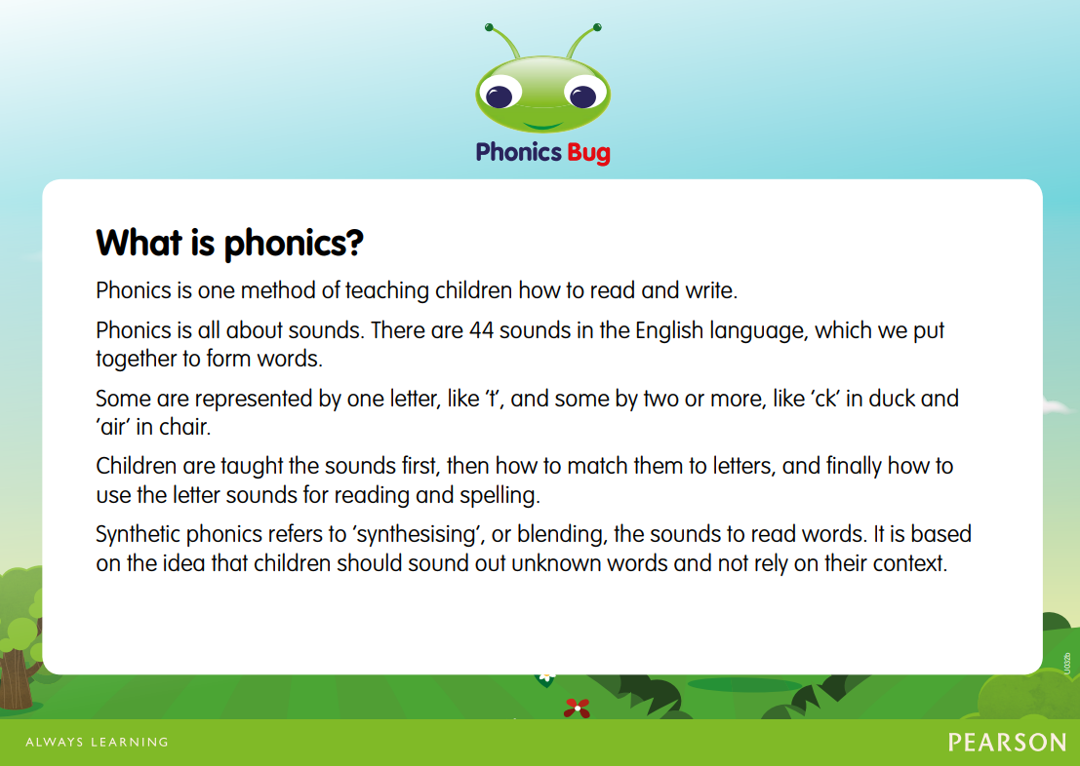

Slide 7
About Letters and Sounds.
The Letters and Sounds scheme is divided into six phases, with each phase building on the skills and knowledge of previous learning.
Children have time to practise and rapidly expand their ability to read and spell words.
They will also learn to read and spell ‘tricky words’. These are not phonetically decodable words.

Slide 8
Phonics at a glance.
Phonics is…
Knowledge of the alphabetic code.
Skills of segmentation and blending.

Slide 9
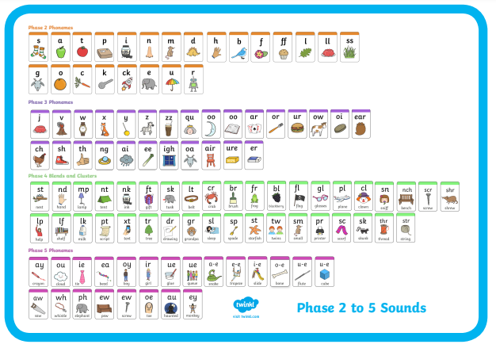
The alphabetic code.
There are 26 letters in the alphabet.
These make up 44 different speech sounds.

Slide 10

A phoneme.
This is the smallest unit of sound in a word.
How many phonemes can you hear in cat?

Slide 11

A grapheme.
This is the letter or groups of letters that represent the phoneme.
Children need to practise recognising the grapheme and saying the phoneme that it represents.

Slide 12
More about graphemes.
Diagraph.
Trigraph.
Adjacent consonants.
Two letters that make one sound.
For example:
fish, shop, rain, window.
Three letters that make one sound.
For example:
high catch bridge
Two or more consonants that are next to each other in a word.
For example:
flap, strip, blank

Slide 13
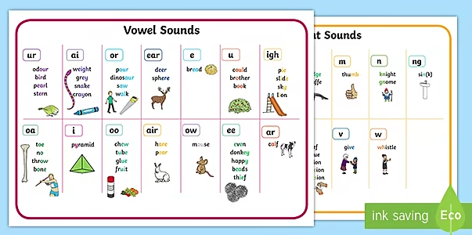
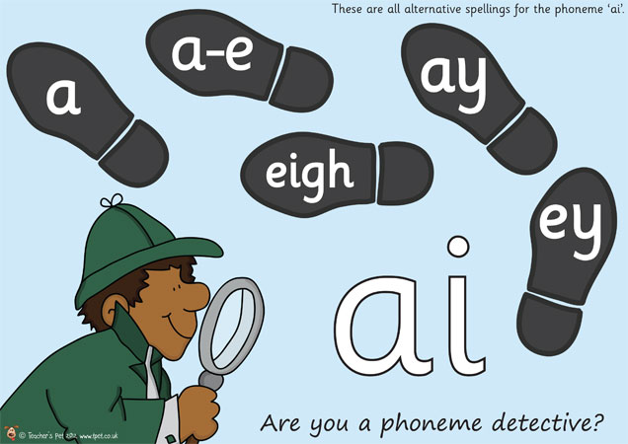
Here is where it get’s tricky!
A grapheme can be pronounced in a different way.
i fin, find ow cow, blow
o hot, cold ie tie, field
c cat, city ea eat, bread
u but, put a hat, what
ch chin, school, chef
ou out, shoulder, could, you
A grapheme can be spelt in a different way.

Slide 14
Split vowel digraphs.
2 letters, making one sound, that are split between another letter eg. a-e in same.
There are 5: a-e e-e i-e o-e u-e
Children need to be taught to recognise these within words so that they don’t say the single letter sounds

Slide 15
Split vowel digraphs.
came
safe
time
plate
phone
cube
flute
even
Words do not have split digraphs if they don’t make the digraph sound.
For example: in have the ‘a-e’ is not making the ‘ai’ sound therefore ‘have’ does not have a split digraph, it is a ‘tricky word’.

Slide 16
How do we teach all of this?
When children are taught a new grapheme they are taught the spelling rules that go with it.
For example, when teaching the ‘oy’ grapheme the children learn that this is usually found at the end of a word.
This helps the children decide which spelling of the sound to use when applying phonics in their writing.

Slide 17
Year 1 Phonics Screening Check.
Week commencing: 9th June 2025.

Slide 18
Why is this phonic screening important?
Children complete a phonic reading check at the end of year 1 so that you the parents are confident that your child has been taught to read successfully.
Accurate word reading at the age of 6 is a good predictor of future reading success.

Slide 19
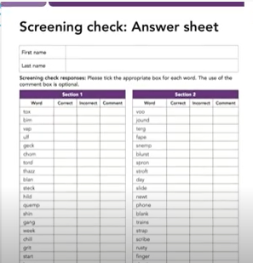
The procedure of the test.
The children will be asked to read 40 words.
They will complete the test one at a time with a familiar adult.
It takes between 2 – 5 minutes.
If they don’t manage to read at least 32 words, they are given extra support and are asked to repeat the test in Year 2.
It means that all children will be able to read accurately before they begin Year 3.

Slide 20
What to expect in the test?
They will read words with 2 and 3 sounds. For example,
in
dog
ship
play

Slide 21
What to expect in the test?
And then words with different letter combinations like
scream
phone
And longer words like
second
tractor

Slide 22
What to expect in the test?
Children will be encouraged to sound out each word.
ship
light
snow

Slide 23
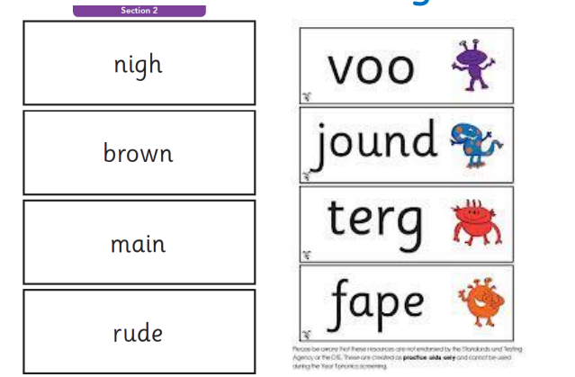
What to expect in the test?
Children will see words that look like this in the test.
alien words
Real words

Slide 24
Some things that children sometimes find difficult.
Trying to make sense of alien words.
For example, stribe might be read as stripe.
Chunking/compound words (pumpkin /strighmer/sunshine)
Confusion between phonemes and their corresponding letter names (a A)
Recognising digraphs/trigraphs within words, especially split vowel digraphs, au, aw, ue, i-e, a-e….
Trying the “alternatives” out especially for vowels
(human, giant, circus)

Slide 25
How can you help?
MAKE READING FUN!
Read as much as possible with your child. Visit the library too!
Read a recipe and cook something together!
Put your child in charge of reading the shopping list.

Slide 26
When reading…
Encourage your child to break up a word into its sounds if they cannot read it on sight. Focus particularly on spotting groups of letters that make one sound. If they struggle encourage them to put the sound buttons on the words before blending.
For example, 2 letters making one sound cow
3 letters making one sound night
2 vowels with a consonant in between spine - i_e

Slide 27
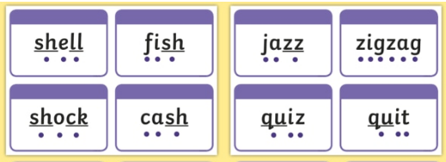
More about sound buttons.
Sound buttons are visual clues on words to help children identify the sounds to read.
https://www.youtube.com/watch?v=42AkGNauKa8

Slide 28
When reading…
If your child is struggling to decode a word encourage them to say each sound from left to right.
Encourage your child to blend the sounds by moving their finger from left to right under the whole word.
Discuss the meaning of words that your child has read.
Encourage and praise – get them to have a ‘good guess’.

Slide 29
After the test.
We will inform you on your child’s progress towards the end of the Summer term.
If your child found the test tricky we will inform you of what support we have put in place to help them improve and what you can do at home to help them as well.
Children who have not met the standard will retake the check when they are in Year 2. All children are individuals and all develop at different rates. The screening check ensures that teachers understand which children need extra help with phonic decoding.

Slide 30
A final note.
Phonics is not the only thing needed to become a fluent reader.
Please continue to read with your child each night and encourage them to:
Make their reading sound like talking
Re-read it if it doesn’t make sense- they may have made a mistake!
Talk about what they read. You could say ‘Tell me about this story’
Most importantly… ENJOY READING!

Slide 31
Useful resources.
A parents guide to Bug Club https://www.youtube.com/watch?v=0dCRWLLNXPo
Year 1 phonic flashcards
https://primarysite-prod-sorted.s3.amazonaws.com/holy-trinity-primary-school/UploadedDocument/9d800c70-15aa-464a-b2ae-4e2a9ee5f57b/year-1-phonics-flashcards.pdf
https://www.theschoolrun.com/what-parents-need-know-about-year-1-phonics-screening-check

Slide 32
Useful online resources.
Download past tests
https://www.activelearnprimary.co.uk/planning#bugclub_phonics
https://www.phonicsplay.co.uk/resources

