Slide 1
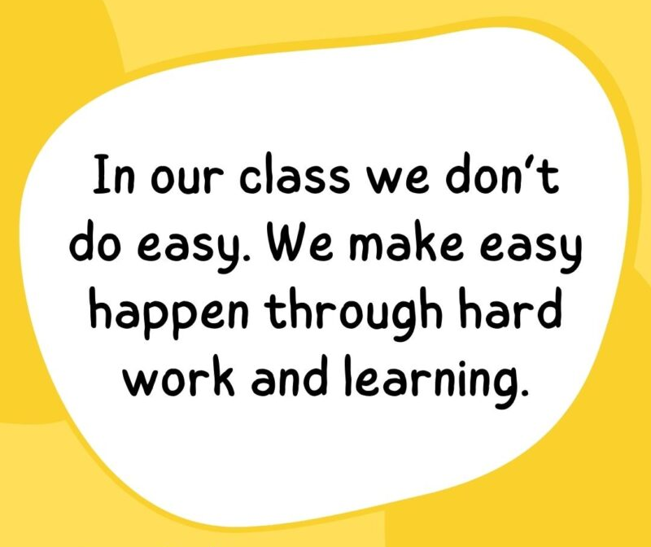
Welcome!

Slide 2
Meet the Teacher
Our aims
How is Year 2 different to Year 1?
What and how does your child learn in Y2?
How is your child assessed in Y2?
How can we help you to help your child?
Questions

Slide 3
Important things to know before we start…
Please ensure that children are wearing the correct school uniform and PE kit. PE is on a Wednesday with Mr Shaw.
Spellings are given each Friday for children to learn throughout the week before their spelling test the next Friday.
Your child’s book will be changed each week (on Friday). Your child’s book bag must be in school every day so we can read with them.
Login details for online learning platforms can be found at the back of your child’s spelling book. If you have any problems with this, please let your child’s teacher know.

Slide 4
How is Year 2 different to Year 1?
Children who have passed the Phonics screening will take part in daily SPAG lessons.
Maths and English are taught using the same schemes of work as Y1 with the Y2 programme of study and teacher assessment framework in mind.
Year 2 children take part in weekly Music lessons with Mrs Matthews.
We take part in a Christmas play and host a Father’s day assembly.
Children will take SATs at the end of the year. This data is no longer reported. It is used as part of the end of year teacher assessments.

Slide 5
What does your child learn in Year 2?
In Maths, we develop their understanding of number, measurement and statistics through practical activities as well as completing bronze, silver, and gold challenges where they will use reasoning and problem-solving skills.
In English, we learn to plan, write and edit a range of text including: a narrative, a non-chronological report, a set of instructions, a poem, a letter, a recount.
In Science we learn about animals (including humans), living things and their habitats, plants and the uses of everyday materials.

Slide 6
What does your child learn in Y2?
In RE, will explore 3 different religions – Christianity, Sikhism and Islam. Children will listen to a range of stories from each religion and make sense of these texts.
In History we will learn the history of travel, the industrial revolution and technology.
In Geography we will
focus on locational knowledge, place knowledge, human and physical geography and geographical skills.
In PSHE they will learn about
the qualities of a good friend, what bullying is, the different jobs that people do, how to keep safe, the importance of being healthy and how to recognise our feelings.

Slide 7
How is your child assessed in Y2?
Children will be assessed when they sit their SATs towards the end of the Year.
Children are typically assessed on Reading, Maths and SPAG (spelling, punctuation and grammar).
These are completed in their classrooms with familiar adults in test conditions. Children will be prepared for this process.
We will use children’s SATs data alongside assessments to inform our judgement.
Children are typically graded as a 2M, 2S, 2D or 2E if they are working at a Year 2 level.
Children who did not pass the Phonics screening will be able to try again this year.

Slide 8
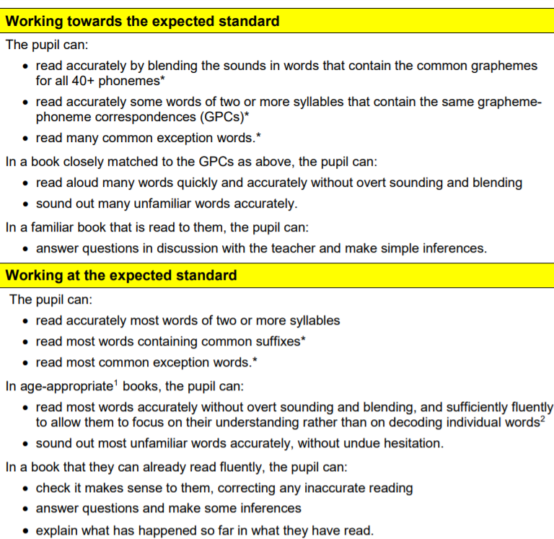
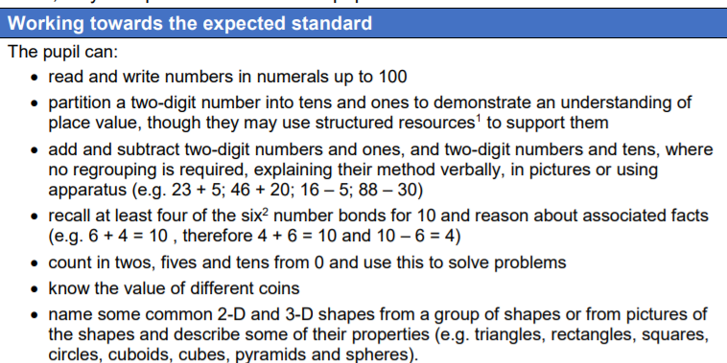
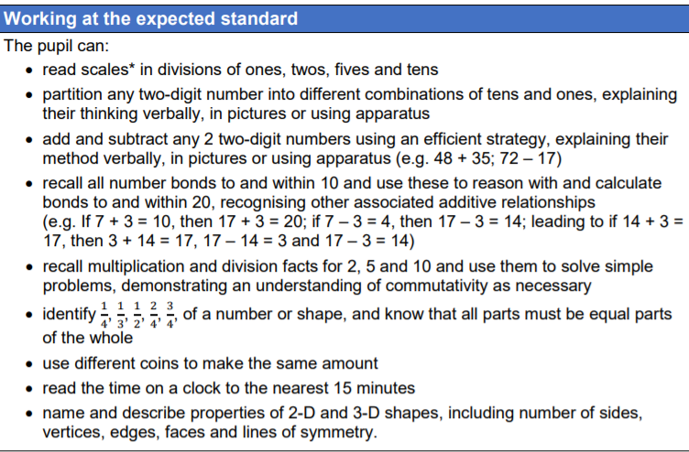
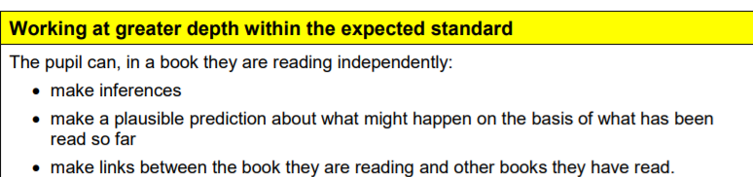
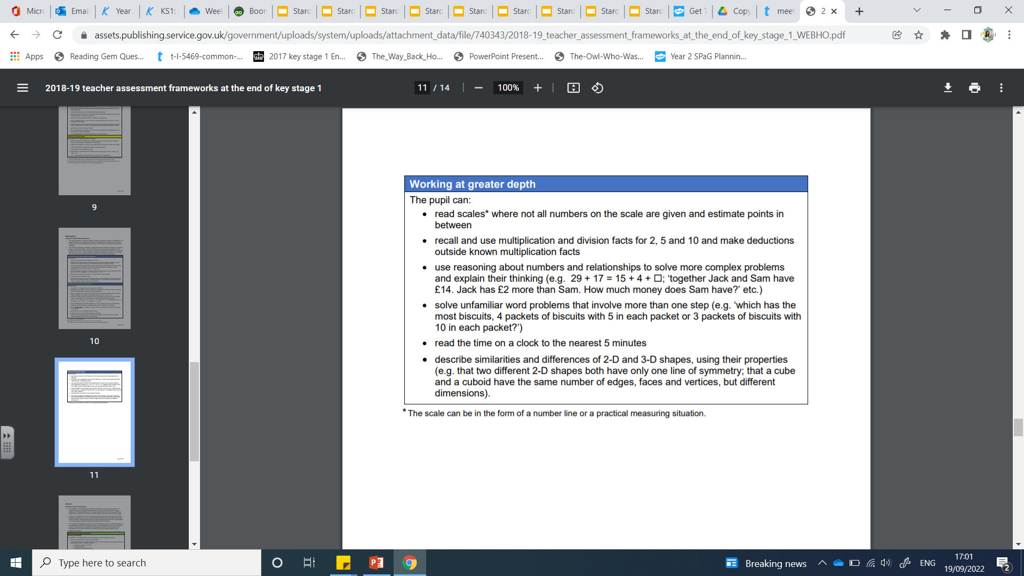

Slide 9



How can we help you help your child?
By the end of the year, children should be able to read all Y2 common exception words. Please practise children’s spellings with them regularly ☺
We will be adding our notes onto Boomreader so stay engaged to see how your child is getting on. Feel free to leave notes about their reading with you ☺
Please encourage a love of reading. Last year, bookmarks were used to record children’s reading sessions at home. This may change.
We will allocate books and games as appropriate on Bug club for children to access at home.
We will be setting a project each half term
By the end of Y2, children should be able to recall and use facts for their 2,3,5 and 10 times tables.

