Slide 1
Year 2 Maths -
The Four Operations

Slide 2
In year 2 children are expected to be able to add, subtract, multiply and divide.
At school we have taught the children strategies to help them solve these types of problems. We would like to share these strategies with you so that you are able to support at home.

Slide 3
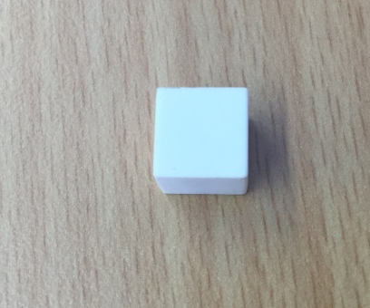
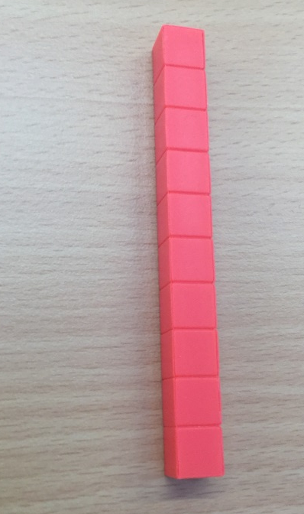
Addition to 100.
When we first introduced adding to 100 to the children they were given practical resources.
We used base 10 resources…
1 stick represents one set of 10
1 cube represents one.

Slide 4
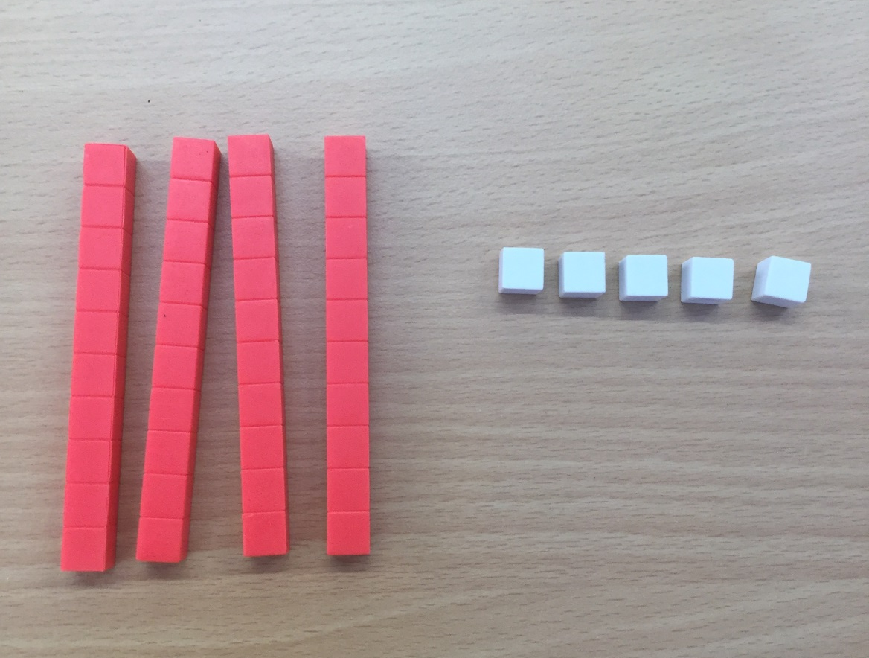
Addition to 100.
So representing a 2 digit number such as 45 would look like this…
4 tens
5 ones
45

Slide 5
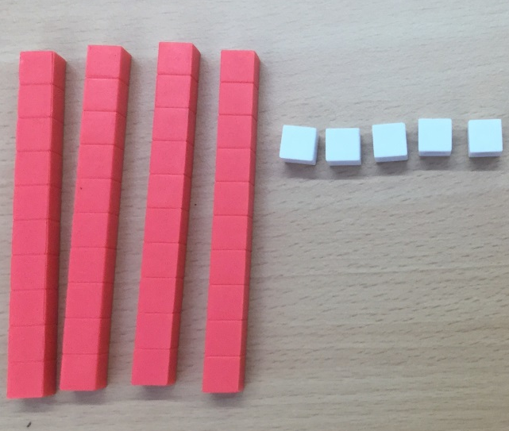
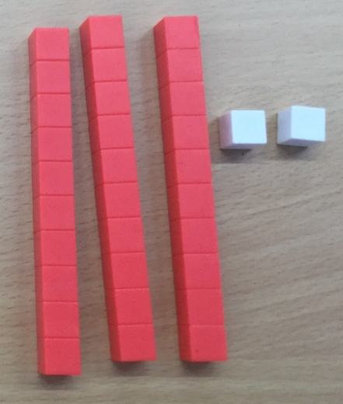
Addition to 100.
If we give children an addition number sentence they can then work it out using these resources…
45 + 32
Count the tens first then the ones.
10,20,30,40,50,60,70 71,72,73,74,75,76,77 it’s 77

Slide 6
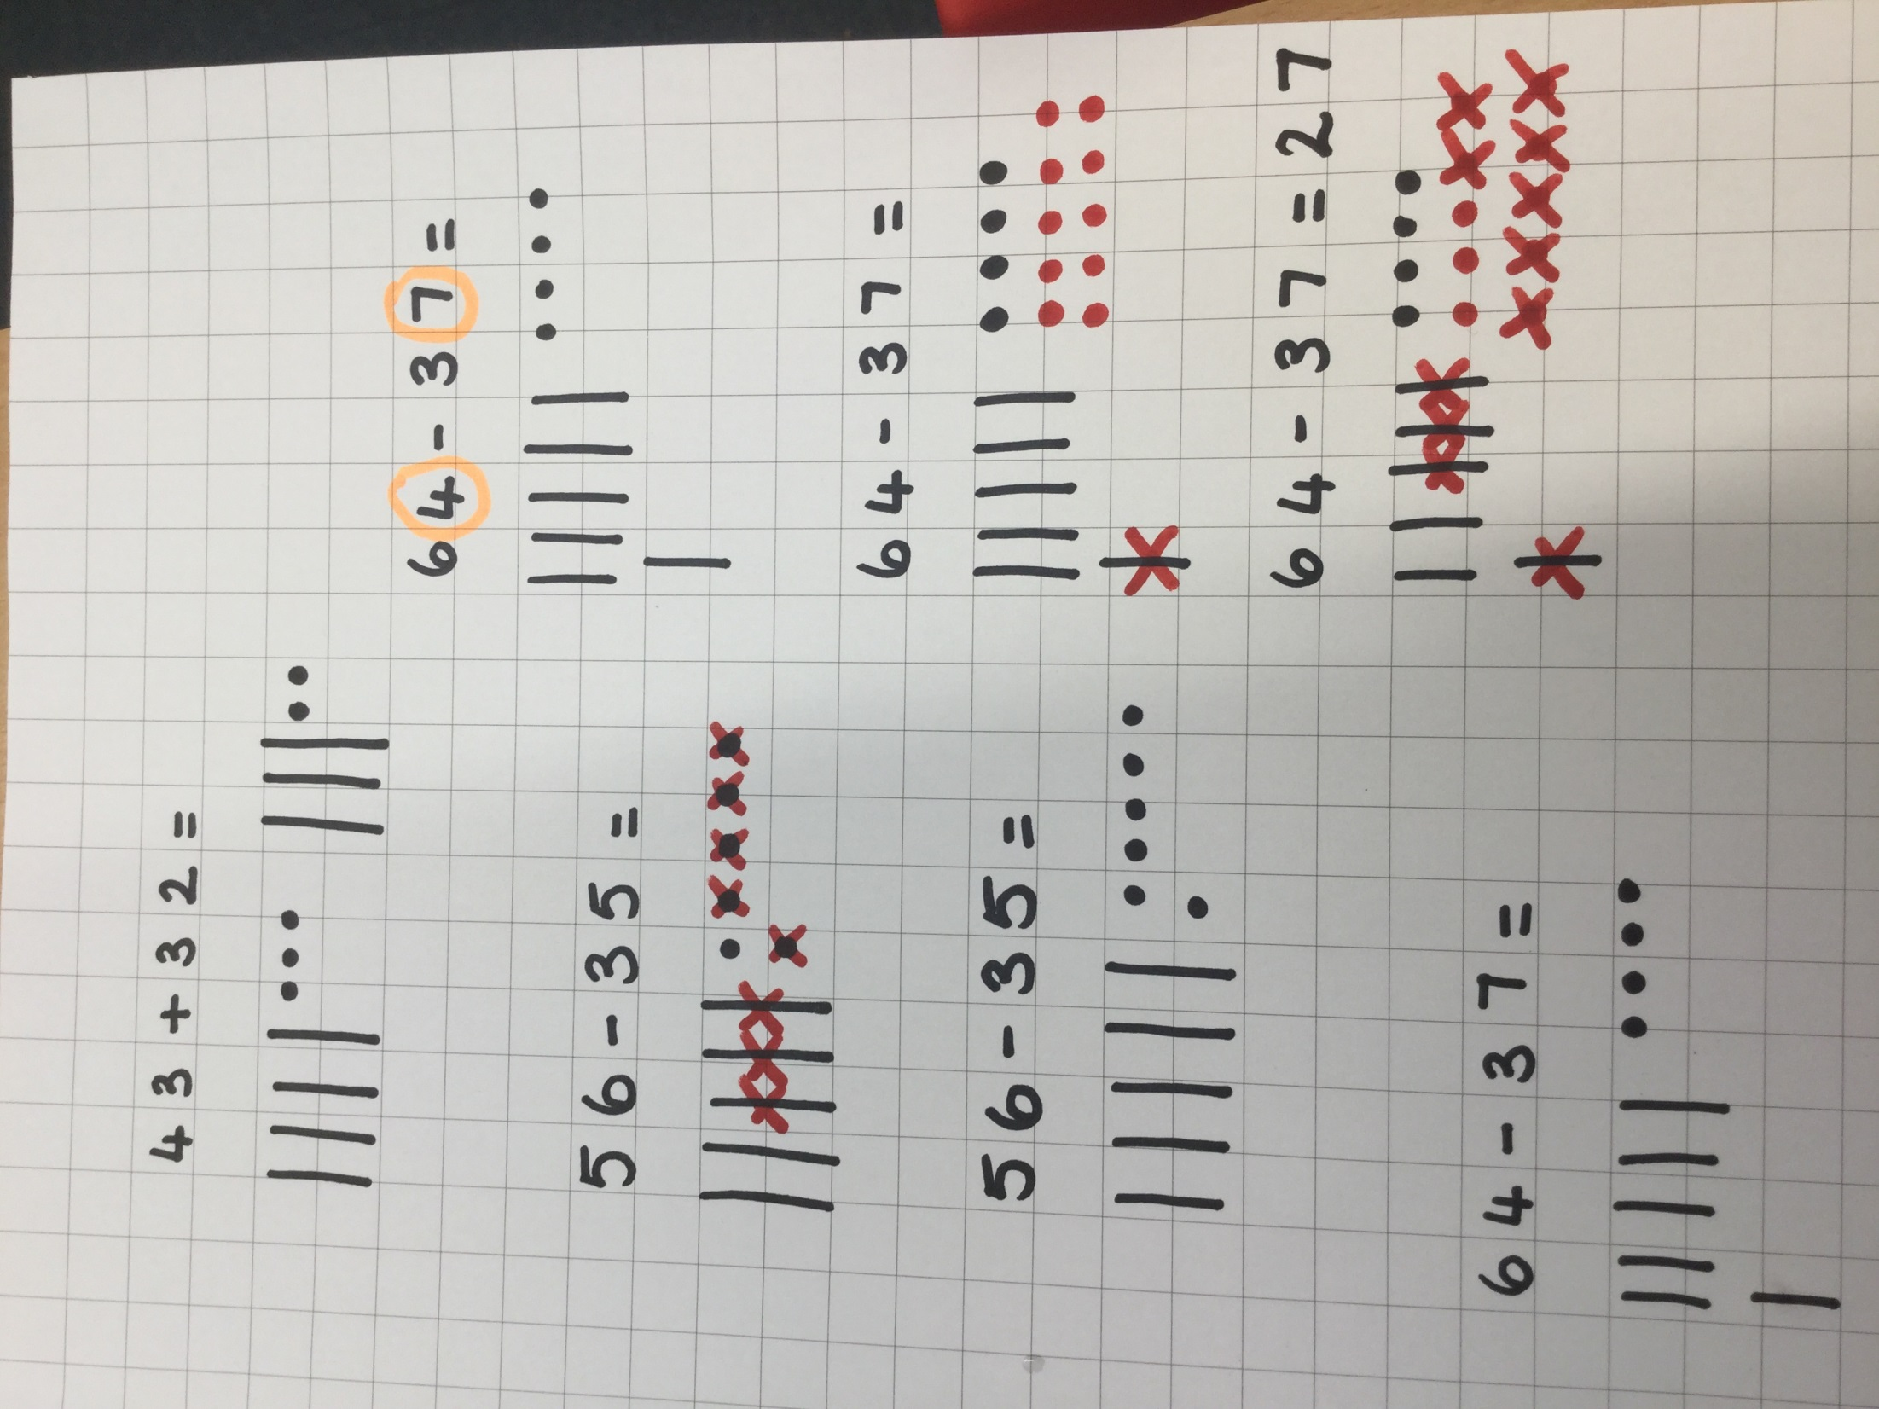
Addition to 100.
Now they are confident solving problems practically with the sticks and cubes, we have moved on and we now get them to draw the sticks and cubes.
The plastic ten sticks are drawn as sticks and the cubes are now dots.
We still count the tens first then the ones.
10,20,30,40,50,60,70 71,72,73,74,75 it’s 75

Slide 7
Addition to 100.
Now they have a simple strategy to solve any addition sum!
Please use this approach at home when you are helping them. ☺

Slide 8

Subtraction to 100.
We use the same approach to drawing out subtraction number sentences.

Slide 9

Subtraction to 100.
We draw the first amount out with sticks and dots but for subtraction we don’t draw the second amount out… we take it away.
Then we count what is left. Counting tens first and then the ones. “10, 20, 21, it’s 21”.

Slide 10
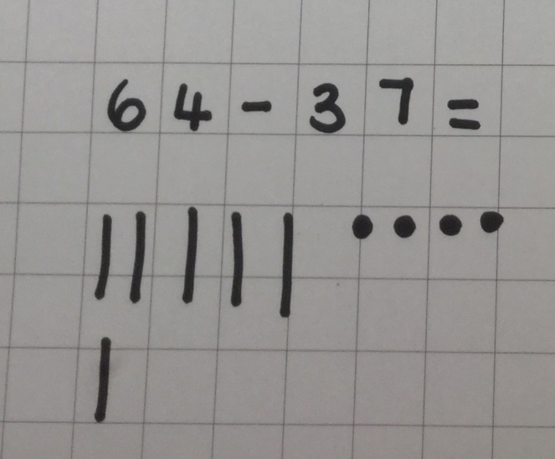
Subtraction to 100.
It becomes a little more complicated when we are subtracting more ones than we have initially.
We can’t cross out 7 ones as we have only drawn 4.

Slide 11
Subtraction to 100.
It becomes a little more complicated when we are subtracting more ones than we have initially.
So we exchange one of the ten sticks for 10 dots.
Now we can solve the subtraction sum.

Slide 12
Subtraction to 100.
Now they have a simple strategy to solve any subtraction sum!
Please use this approach at home when you are helping them. ☺

Slide 13
Multiplication
We teach children to identify the multiplication symbol so that they are able to read number sentences like...
4 x 5 =
They learn that this means “lots of”.

Slide 14
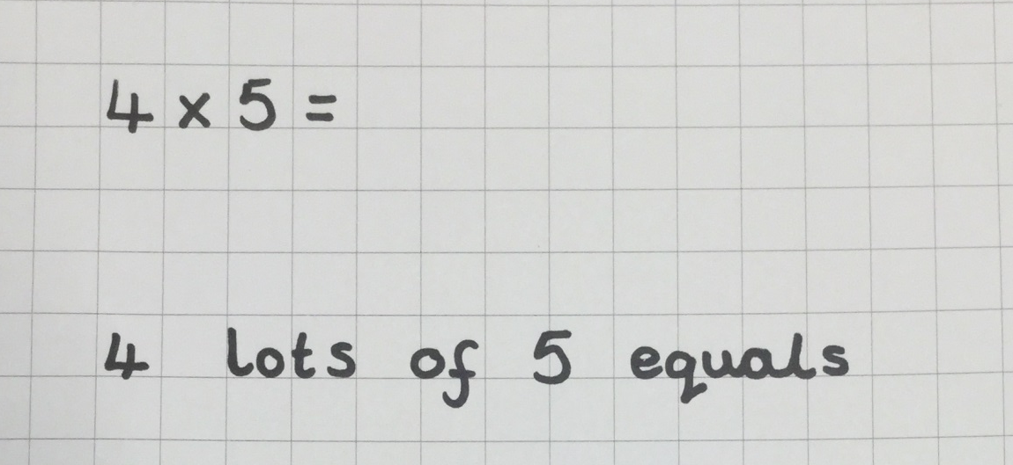


Multiplication

Slide 15
Multiplication
We are also teaching the children the 2, 3, 5 and 10 times tables.
2 times tables | 3 times tables | 5 times tables | 10 times tables
1 x 2 = 2 | 1 x 3 = 3 | 1 x 5 = 5 | 1 x 10 = 10
2 x 2 = 4 | 2 x 3 = 6 | 2 x 5 = 10 | 2 x 10 = 20
3 x 2 = 6 | 3 x 3 = 9 | 3 x 5 = 15 | 3 x 10 = 30
4 x 2 = 8 | 4 x 3 = 12 | 4 x 5 = 20 | 4 x 10 = 40
5 x 2 = 10 | 5 x 3 = 15 | 5 x 5 = 25 | 5 x 10 = 50
6 x 2 = 12 | 6 x 3 = 18 | 6 x 5 = 30 | 6 x 10 = 60
7 x 2 = 14 | 7 x 3 = 21 | 7 x 5 = 35 | 7 x 10 = 70
8 x 2 = 16 | 8 x 3 = 24 | 8 x 5 = 40 | 8 x 10 = 80
9 x 2 = 18 | 9 x 3 = 27 | 9 x 5 = 45 | 9 x 10 = 90
10 x 2 = 20 | 10 x 3 = 30 | 10 x 5 = 50 | 10 x 10 = 100
11 x 2 = 22 | 11 x 3 = 33 | 11 x 5 = 55 | 11 x 10 = 110
12 x 2 = 24 | 12 x 3 = 36 | 12 x 5 = 60 | 12 x 10 = 120

Slide 16
Multiplication
So if they know these timetables they can solve multiplication sums much quicker…
e.g. 9 x 5 =
Put up 9 fingers
Count in steps of 5 for each finger.
Stop on the 9th finger – you have your answer.

Slide 17
Multiplication.
Now they have two simple strategies to solve multiplication problems!
Please use these approaches at home when you are helping them. ☺

Slide 18
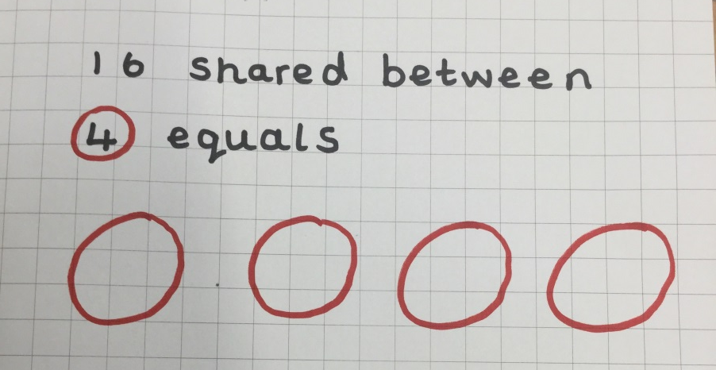
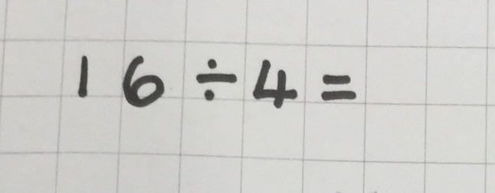
Division
We have taught the children to recognise the division symbol.
We have taught them that division is the same as saying “___ shared between _____ is ____.”
So the first number is the whole number and the second number tells us how many groups to share equally into.

Slide 19
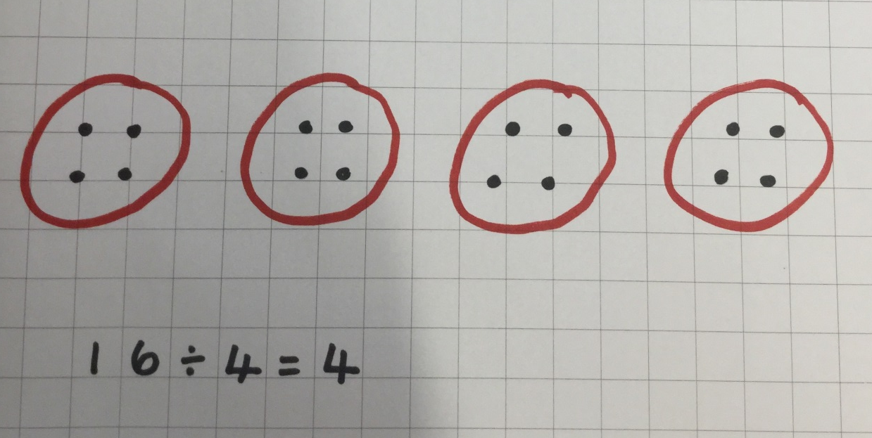
Division
Children draw the groups and then share out the whole number one at a time between the different groups.

Slide 20
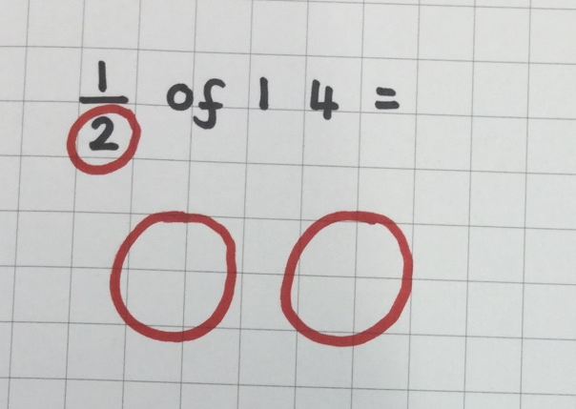

Fractions
We have taught the children a similar approach to working out fractions.
We have taught the children that the digit at the bottom of the fraction tells us how many groups the whole number is being split into.
We then share out the whole number equally taking it in turns to give each group a dot one at a time until the whole number has been shared out

Slide 21



Fractions
This is the same for quarters…
… and for thirds.

Slide 22


Fractions
Sometimes fraction questions want the children to find more than one quarter or third.
If it asks for 2 quarters of an amount, instead of just one, we start off exactly the same.
Once the whole number has been shared out, we look at the digit at the top of the fraction and circle that many of the groups. We then count how many there are in those groups and it will give us the answer.

Slide 23
Today’s Workshop
Today we are going to make a snakes and ladders game with an added challenge.
First, make the dice and counters using scissors and glue provided.
Next, use the colours on your table to colour the squares on the board in a mix of the different colours (blue, green, pink, yellow)
After that you need to get some cards (6 blue, 6 green, 6 pink and 6 yellow)
Then on each of the flash cards you are going to write one sum.
Addition sums on blue cards. E.g.
Subtraction sums on green cards. E.g.
Multiplication sums on pink cards. E.g.
Division or fraction sums on yellow cards. E.g.
58 + 36 =
84 - 43 =
4 x 10 =
12 ÷ 3 =
Make sure the numbers you choose divide equally.
5. Finally you are ready to play snakes and ladders. When
you land on a coloured square, you must pick up a card of that colour and answer the sum on it before playing on.

