Slide 1

Welcome Parents!
Y3 Parents Meeting
Thursday 12th September 2024

Slide 2
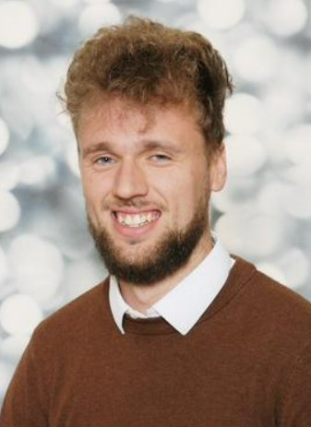
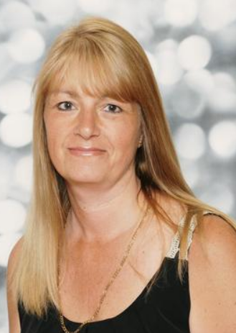
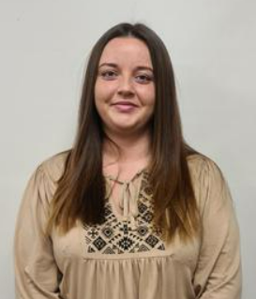
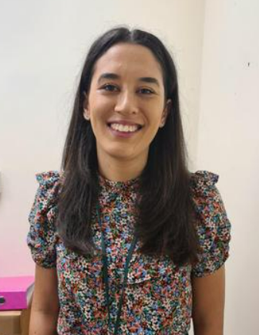
MEET THE TEACHERS
3C
3R
Mr Corbett Class Teacher
Mrs Talbot
T & L Assistant
Miss Johnson
T & L Assistant
Miss
Roberts Class Teacher

Slide 3
Welcome to Year 3
The School day
The curriculum
English, Maths
Science & Foundation Subjects
Reading –online
Homework
P.E
Uniform
Topics

Slide 4
The School day
8:35 – 8:50 – Morning Task (Maths and English Basic skills)
8:50 – Collective Worship
9:15 – TTRS
9:20 - Lesson 1
10:20 – Handwriting
10:40 -- Playtime
11:00 – Lesson 2
12:0 – Guided Reading/SPaG
12:30 – 1:30 Dinnertime
1:30 – Lesson 3
2:30 – Lesson 4
3:15 – Home time

Slide 5
Year 3 Curriculum
English - The Write Stuff
Maths - White Rose
Science
History, Geography, Religious Education. Computing, PE, PSE, Art, D&T and Music
Stone Age Boy | Autumn is Here | Skara Brae | Skeletons and muscles | How does a Robo-Dog work? | The Flood | Wolves in the wall
Number Place value Addition and Subtraction | Number (Multiplication and Division) | Length and perimeters Fractions | Fractions Mass and capacity | Fractions Money Time | Shape Statistics
Rocks | Plants | Animals including humans | Light | Forces and magnets

Slide 6
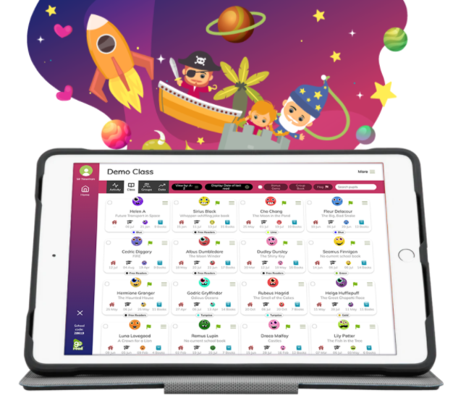
Reading
Expectations:
Children should be reading everyday. This doesn’t have to be just their reading books. Children can read library books, magazines and age appropriate newspapers.
Parents need to go on the Boom Reader app to comment on their child’s reading at least once a week.
If you’re struggling to access any of the platforms, please speak to us.
We will be continuing to use ‘Go Read.’
It has been renamed ‘Boom Reader’ but it still fulfils the same purpose.

Slide 7



Homework
We will be setting a project at the start of every half term based around our topic learning.
Projects will be due in on the final week of that half term.
The next project will be set on the first week after October half term (Tuesday 5th November 2024). We will also put this project onto google classroom.
Login’s are currently being set up. When they are reading, we will stick them into the back of their spelling books for you to see.
Other online homework…

Slide 8
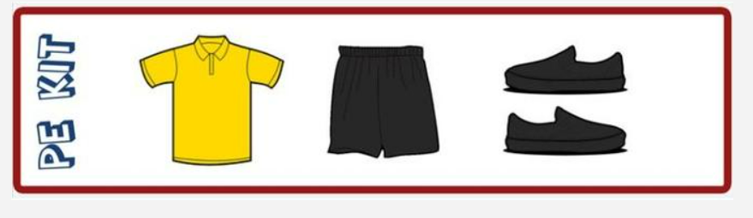
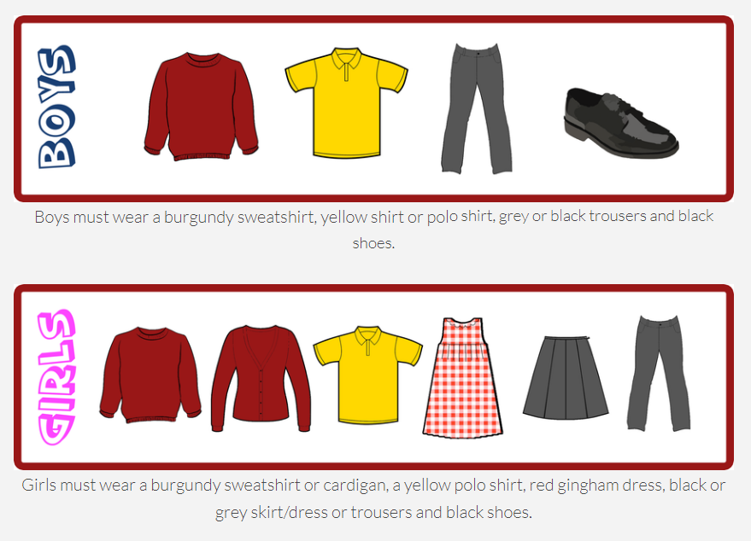
P.E Kit
Uniform
The PE kit should consist of a yellow polo shirt, school jumper, a pair of black shorts or jogging bottoms and a pair of black pumps or trainers

Slide 9
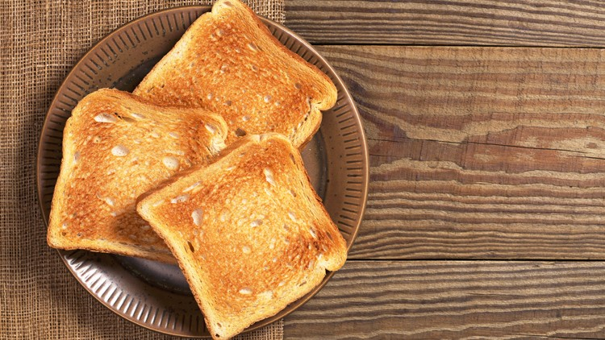
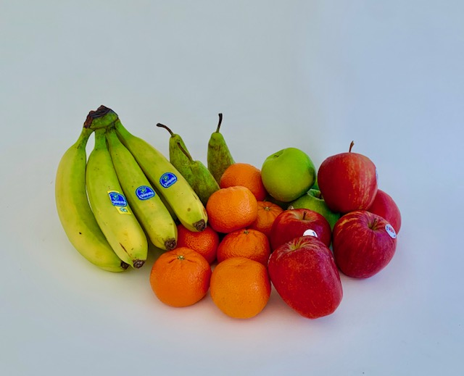
Toast
Snacks
Children can bring a piece of fruit for their snack at Playtime if they wish to (No chocolate/sweets please!)
Children are welcome to have toast each week at a cost of 50p however this needs to be paid online (Gateway). You will need to pay at the end of every half term for your child to have toast the following half term.
Children can also have milk at break times which also needs to be paid online.

Slide 10
Good behaviour
We continue to follow the “Good to be Green” approach with our behaviour management.
Non-verbal warning
Verbal warning- blue stop and think card-
Yellow card (miss 5 mins play)
Red card (miss 15 mins play)
Behaviour recovery (Senior leaders office)
Praise Assembly
Praise Assembly will take place on Friday Morning. If your child has been selected for praise you will receive an invitation on the Thursday before to join us in celebrating your child’s achievements at 8:50am.
Halos
Children will receive halos for showing our learning behaviours. These can be then spent in our halo shop every half term.

Slide 11
What you can do to help at home?
Listen to your child read even if this is not their school reading book.
Ensure that your child completes their topic project.
Practise spellings, times tables and writing.
Ensure your child is in school everyday and on time.
Talk to your child about their learning from the day.

Slide 12
Any Questions?

