Slide 1

Welcome Parents
Y4 Parents Meeting
Wednesday 11th September 2024

Slide 2
Our School Day
8:35 - Gates open
As soon as soon come in, there will be a morning task waiting for them / 1:1 sessions / closing gaps in learning / intervention groups/ readers
8:45am - Registration
11:30-12:30pm -Lunch time
3:15pm - Home time

Slide 3
Welcome to Year 4
Reading
Multiplication Check
Homework
P.E
Swimming
Uniform

Slide 4

Reading
Expectations:
Reading – everyday.
(Library books, reading book, magazines, etc)
Discuss books
Signed at least once a week by adults or children on go read app

Slide 5
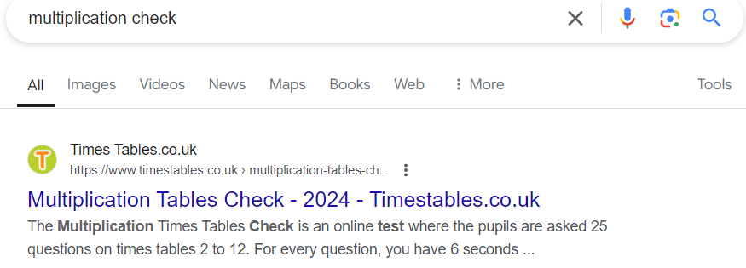
Multiplication Check
Expectations:
At the end of year 4, during the month of June, children will take a multiplication check.
They will need to learn all of their times table (2-12).
Children will complete 25 questions, 6 seconds per question on the tablet.
You can practice for the test by searching:
google- multiplication check

Slide 6



Homework
Children will be allocated a reading book, please encourage your children to read daily. You must record comments at least once a week on go read.
Each week on a Friday children will be given spellings and they will have a spelling test the following Friday. Children will be expected to practice these spellings 3 times a week, not all in one day. These spellings will be taken from year 4 common exception words and statutory spelling rules.
Projects will be set each half term and submitted before the holidays. This will be based around learning in school.
Homework will be set on google classroom. This could be reading extracts before a lesson, a Maths video to help re-cap learning in school or extra interventions for some children.
Other online homework… Google Classroom

Slide 7
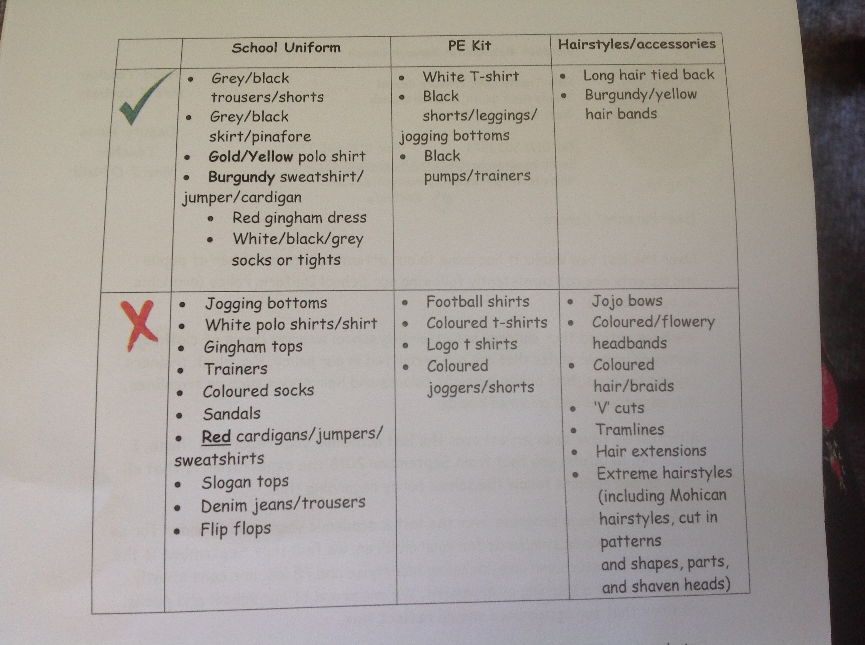
Black trainers
Joggers or shorts
Yellow polo shirt

Slide 8
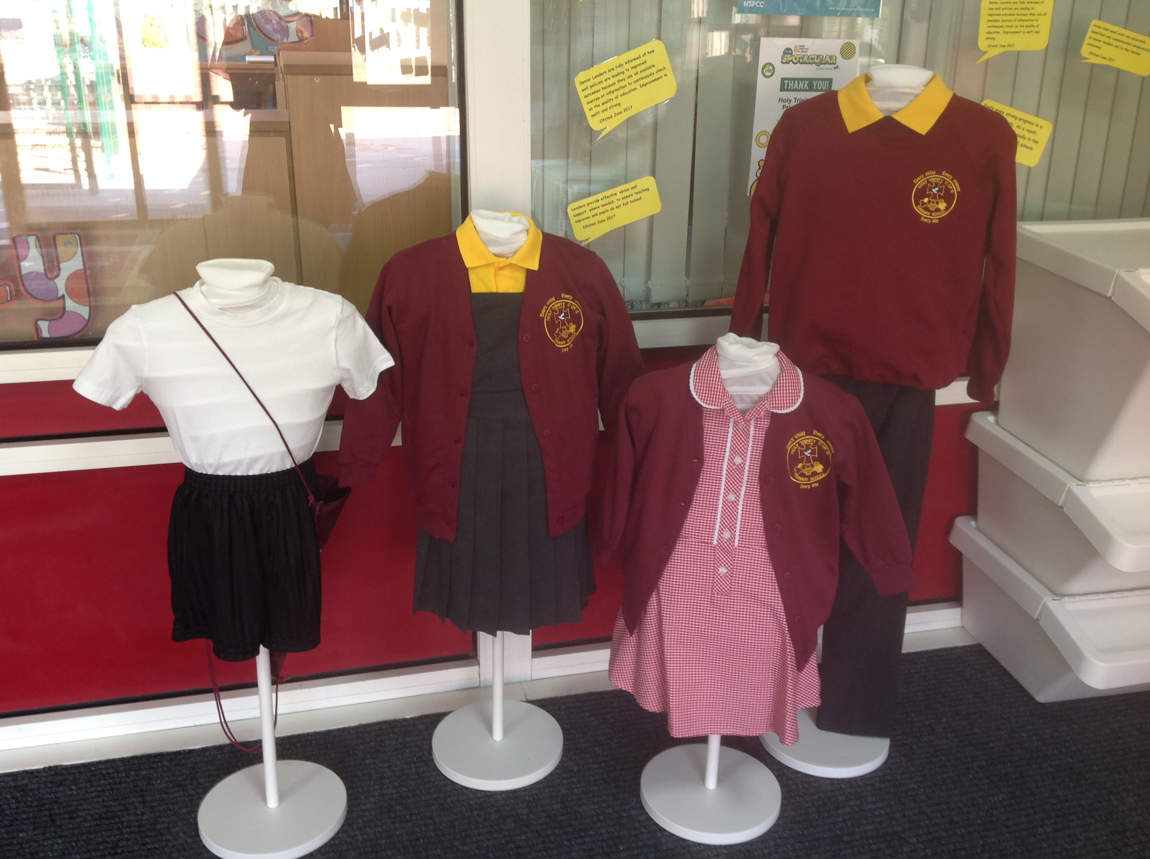

Slide 9
Swimming and PE
4M will be going swimming starting 13th September and will run till February half term.
Swimming lessons will now be for 1 hour.
4S will be going swimming after February half term and will run through the whole academic year
4S will have PE on a Tuesday while 4M attend swimming, this will alternate in February
It is vital children attend swimming lessons and wear their PE kits when required
Children MUST bring a towel and swimming cap.
Children can buy a swimming cap from the centre. Each cap is worth £2.00.
Boys
Swimming shorts
Girls
-one piece swimming suit
-hair must be tied back
No jewellery allowed

Slide 10
What you can do to help at home?
Listen to your child read as this will be our main focus in year 4
Ensure that your child completes their homework
Practise spellings, times tables and sentence writing.
Ensure your child is in school everyday and on time.
Talk to your child about their learning.
Help to keep your child and others safe.

Slide 11
Questions?

