Slide 1

PLAS GWYNANT OUTDOOR EDUCATION CENTRE
SANDWELL RESIDENTIAL EDUCATION SERVICE
Notes:
Give short outline of Centre and its development and refurbishment

Slide 2
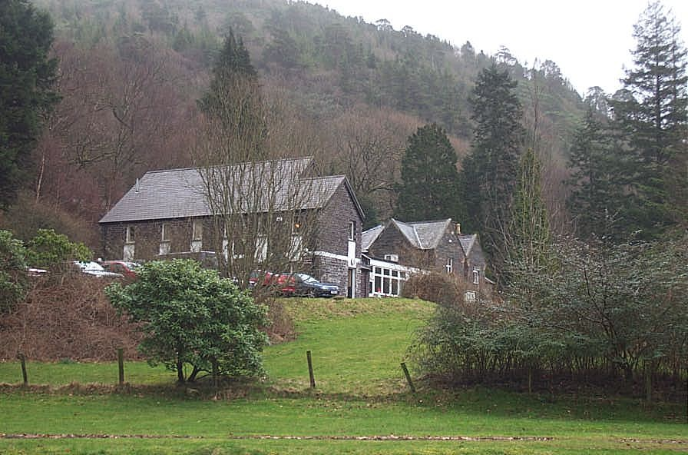
Plas Gwynant
Notes:
2
Give short outline of Centre and its development and refurbishment

Slide 3

Plas Gwynant
September 2024
To book a residential course, school has to commit to paying for a minimum of 42 pupils.
The centre holds 48 pupils, it is possible to take more pupils by having a split course over a full week.
Schools pays the full cost of £270 per pupil and asks that children from Holy Trinity make a contribution to that amount.
This year unfortunately only 27 pupils went which meant that school paid for 15 empty places as well as subsiding the 27 who attended.
The difficult decision has been made to run the course every 2 years to try and fill the numbers.
Notes:
3

Slide 4
Pre Course Arrangements
A course at Plas Gwynant will include lots of fun, new learning experiences and the opportunity for your child to develop personal and social skills
It will greatly enhance their school education through an organised programme of outdoor learning experiences
The children will be accompanied by school staff and appropriately qualified and experienced Plas Gwynant staff
For a visit to run smoothly a great deal of planning is required, e.g. collect medical information, inform centre of any dietary requirements.

Slide 5
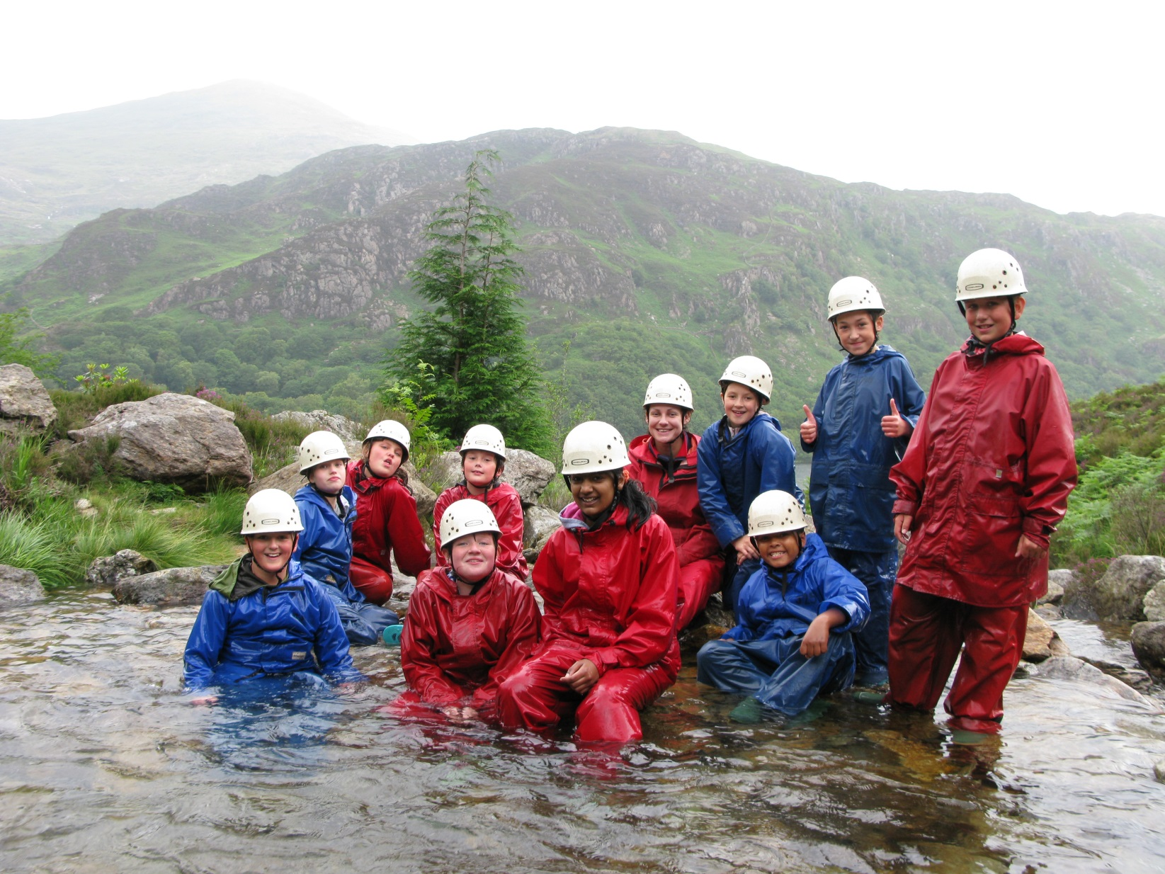

Slide 6
Activities
As all activities are subject to the prevailing weather conditions it is not possible to issue a fixed weekly programme in advance
Possible activities to be undertaken during a Primary visit are:
Team building activities
Orienteering
Open boating
Mountain walk
Beach exploration
Abseiling
Mine visit
Castle visit
Gorge walk

Slide 7
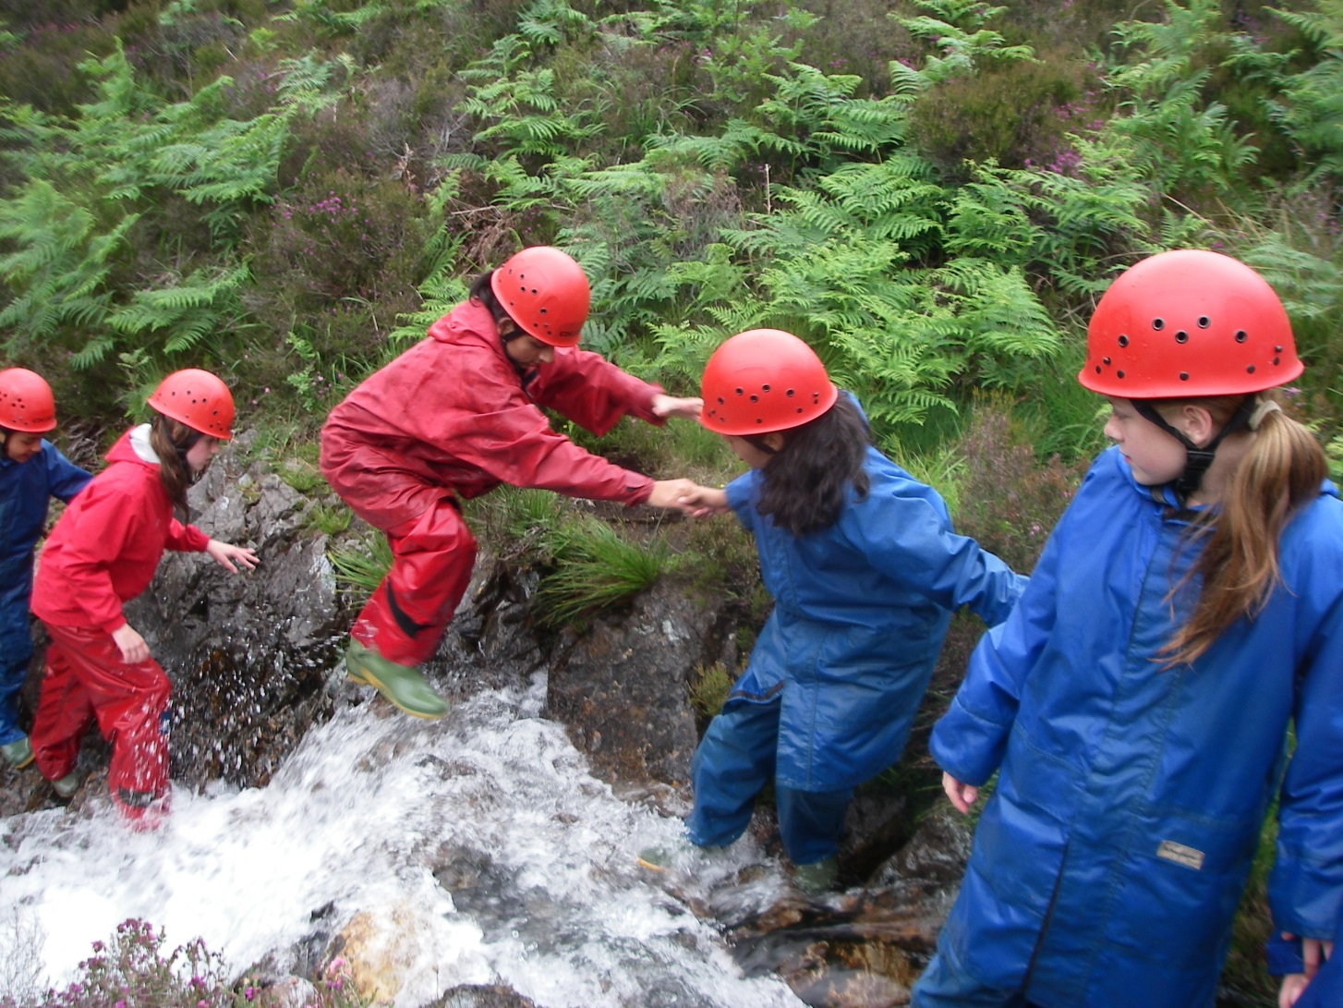
Team Building!

Slide 8
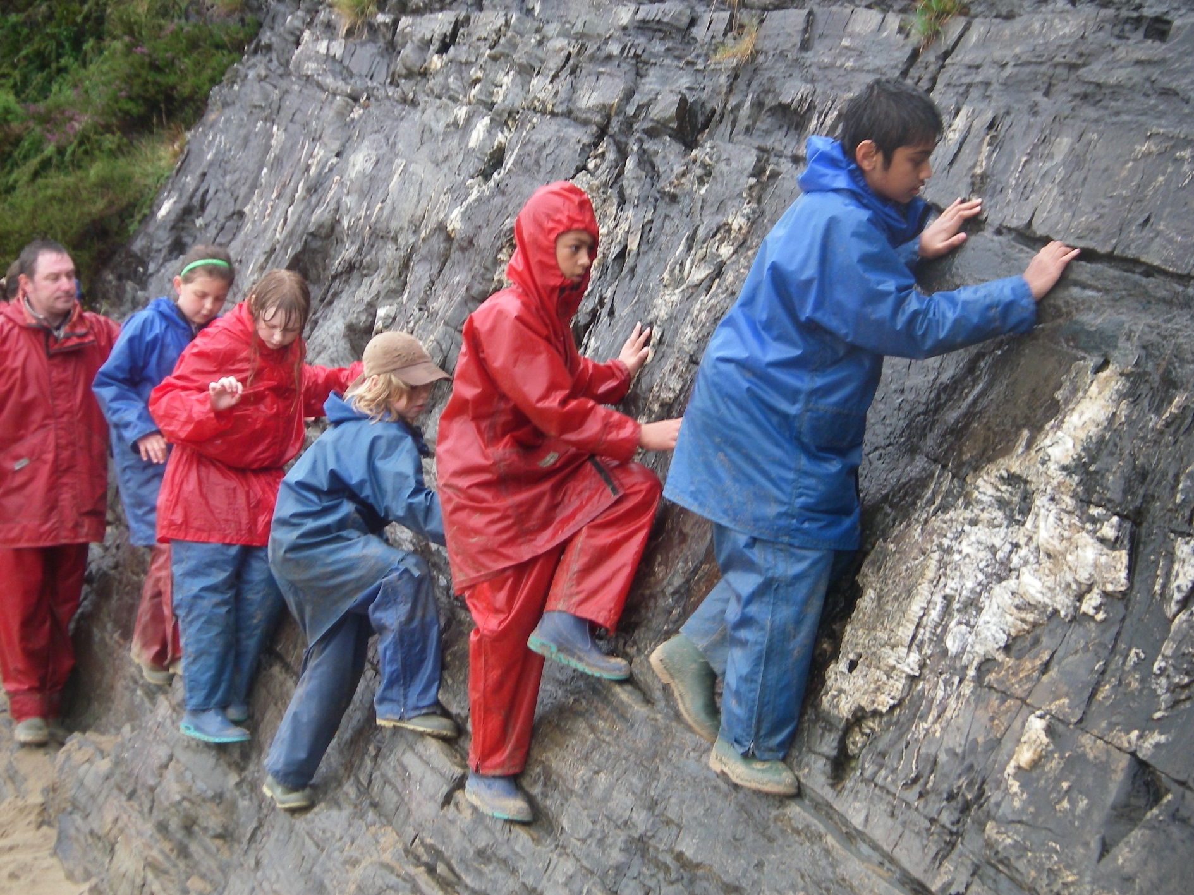
Notes:
Run through likely activities - using slides as prompts

Slide 9
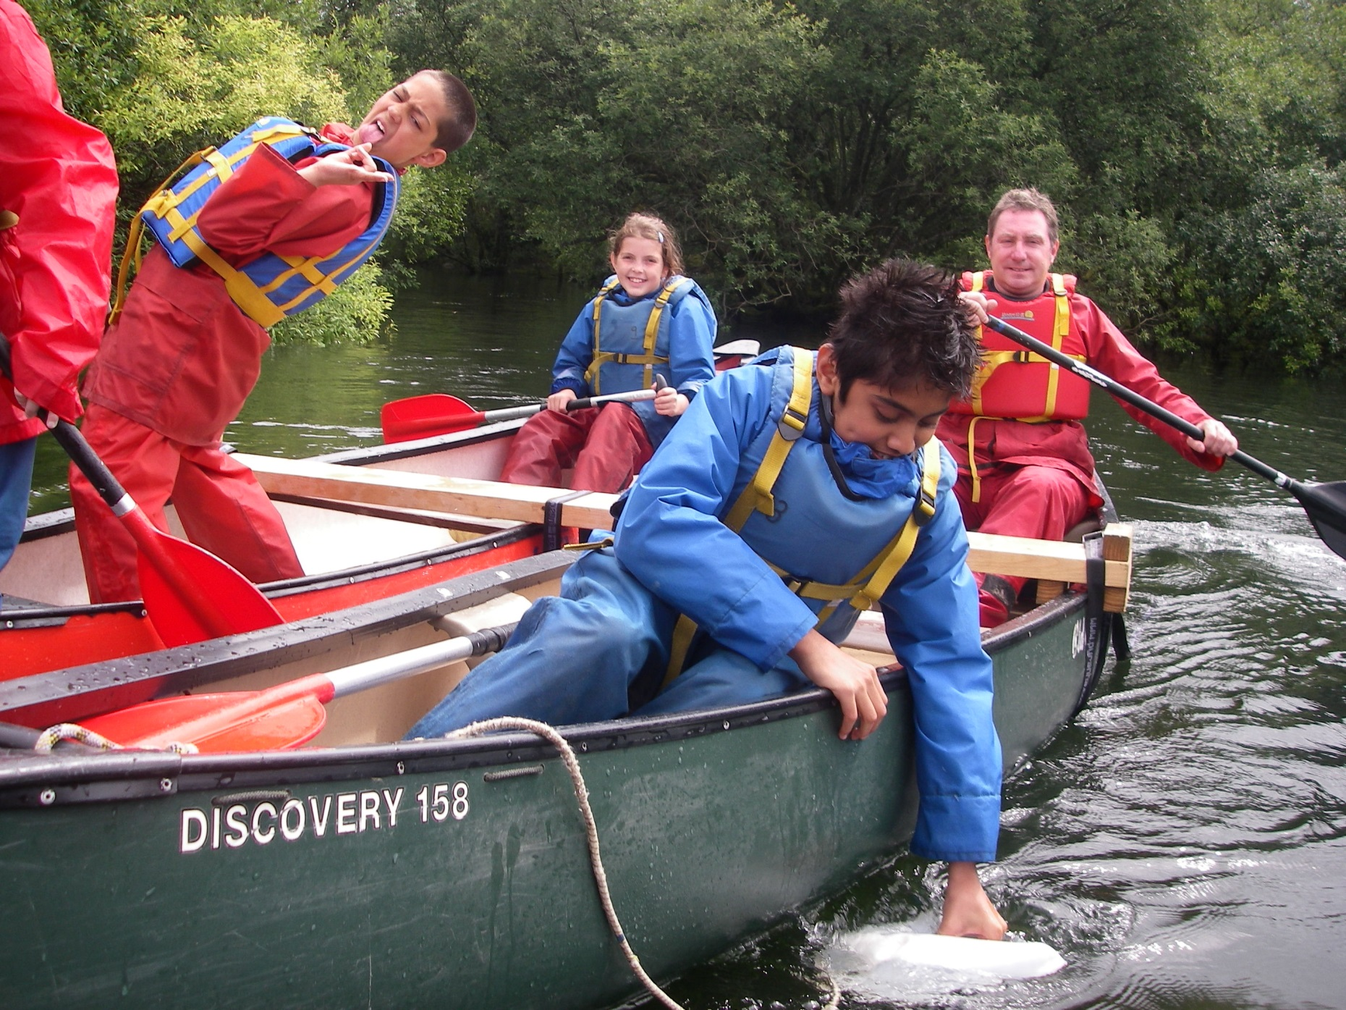

Slide 10
KIT LIST
    A kit list will be provided - this list is a minimum only
    All specialist outdoor equipment including waterproofs and rucksacks will be provided by the Centre
    The clothes worn for activities will get dirty, wet and scruffy so do not bring your best things!
    Wellington boots are optional and will be needed but they can be provided by the Centre so you do not need to buy them
Notes:
Give details of Centres whereabouts, coach arrangements to and from the Centre, require packed lunch, in their own lunch box which they will use all week.

Slide 11
PLAS GWYNANT STUDENT KIT LIST
*All specialist outdoor equipment including waterproofs and rucksacks will be provided by the Centre. *The clothes that you bring to wear for activities will get dirty, wet and scruffy so do not bring your best things! *This list is a MINIMUM.
Essential – for either summer or winter
Sufficient underwear and socks for the course length Towel(s) and toiletries Night clothes and slippers Indoor clothes and shoes 3 T Shirts Woolly hat and warm gloves – yes, even in summer! Lunch box & Torch |  | 3 warm woolly jumpers or fleeces 2 pairs of warm loose fitting trousers (NOT jeans) 1 long sleeved T shirts or football shirts 3 pairs of thick walking socks 2 pairs of old trainers – at least one pair will get wet Swimming costume
Additional items according to season:
Summer | Items available at the school shop
Sun hat, sun cream, sun glasses 2 pairs of shorts, extra T shirts Midge repellent - Plas Gwynant midges have voracious appetites! | Torches, AA batteries Postcards, posters Stamps Gloves, socks, hats etc Pens, pencils, rubbers, small notepads
Optional
Wellington boots if you have them – not fashion wellies! Paper and pen or pencil Camera - disposables are good Reading books | Mobile Phones : Please note: - there is no mobile phone signal at Plas Gwynant. Chewing Gum: No chewing gum allowed – do not bring gum with you

Slide 12
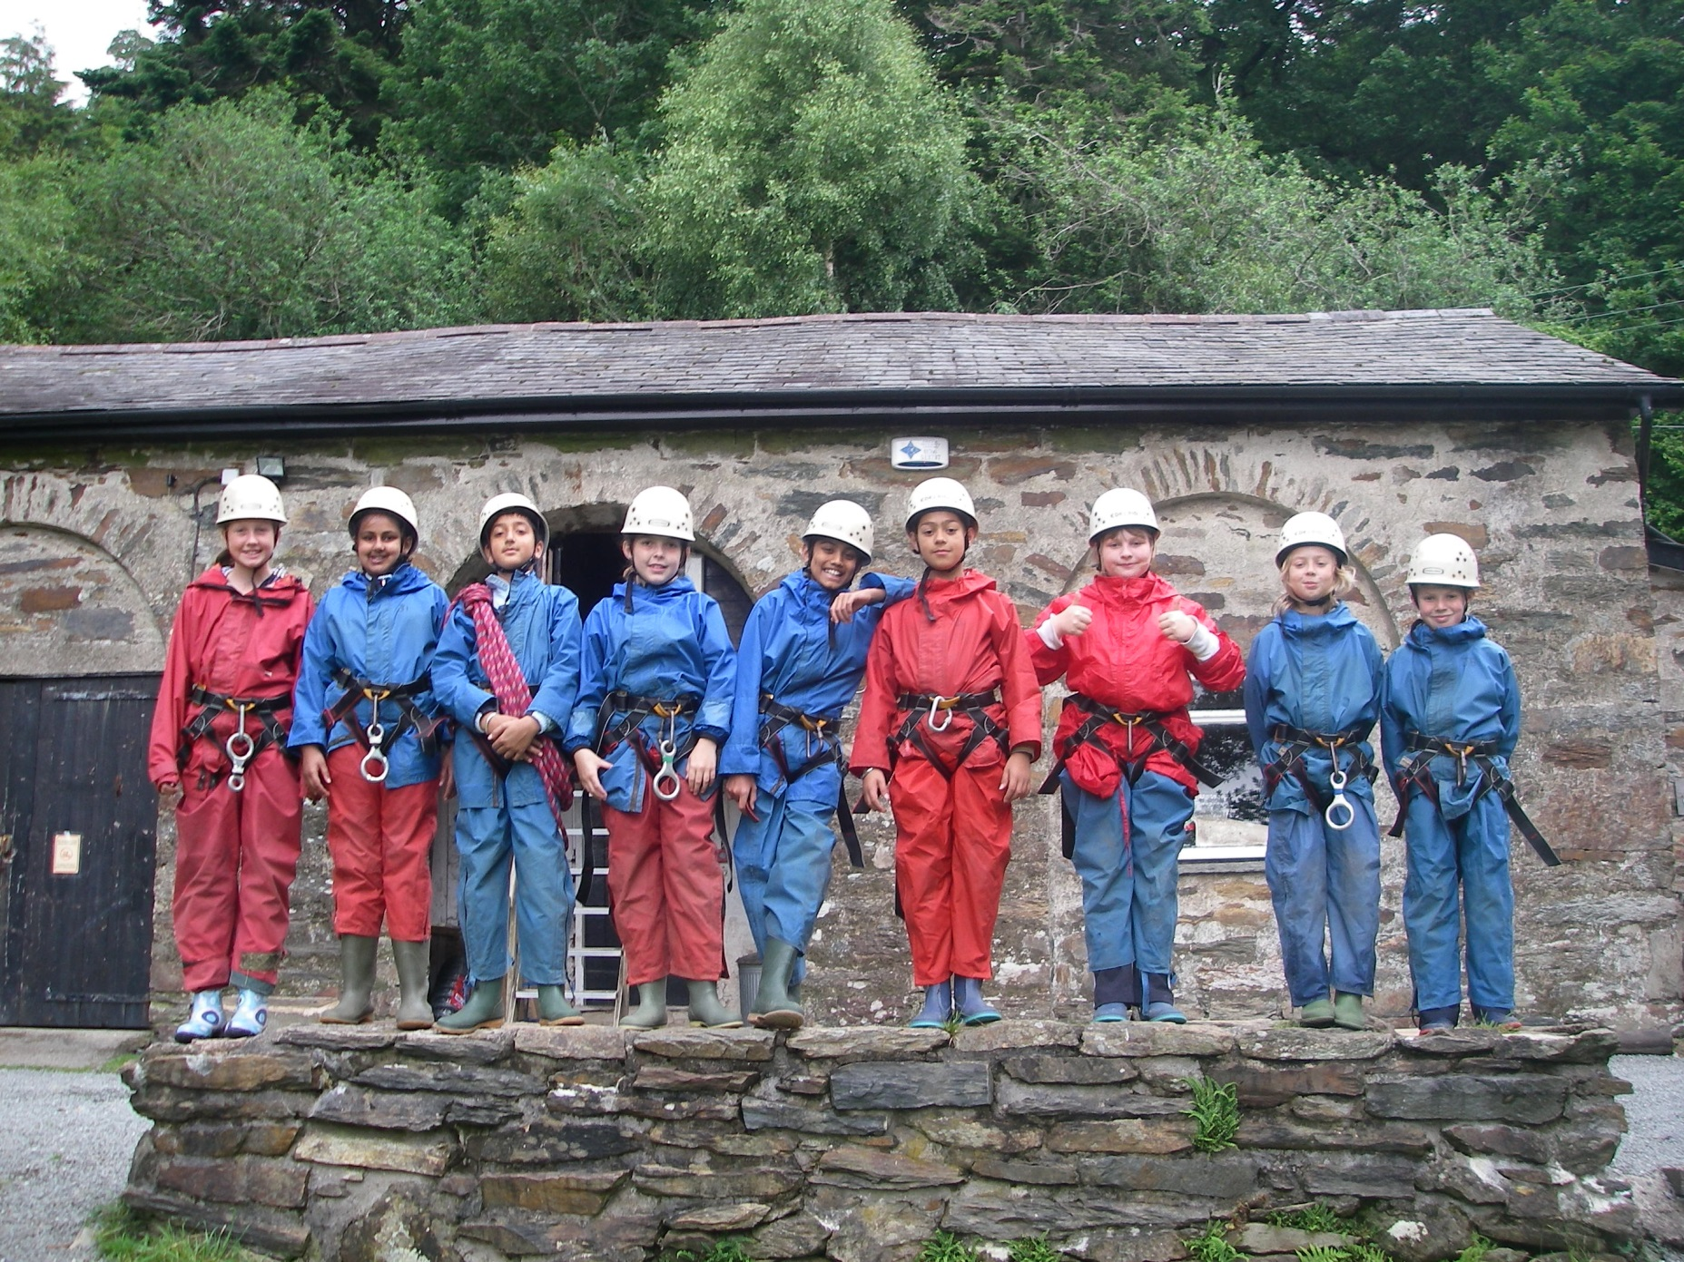

Slide 13
Dietary Information
All meals are provided for the children whilst at Plas Gwynant – breakfast, lunch and evening meal as well as an afternoon teatime snack.
Parents should ensure staff organising the residential visit are aware of any special dietary requirements their children have well in advance
Please provide as much information as possible
Centre catering staff are happy to provide for a wide variety of special needs including those for vegetarians, vegans, diabetics, and for students with allergies

Slide 14
Medical Information
Parents should ensure staff organising the residential visit are aware of any medical conditions.
Please provide as much information as possible
Staff will need clear instructions on medicine e.g. what it is, what it is for, when to have it and how much.
All medicines must have the name and class of the child written on it.

Slide 15
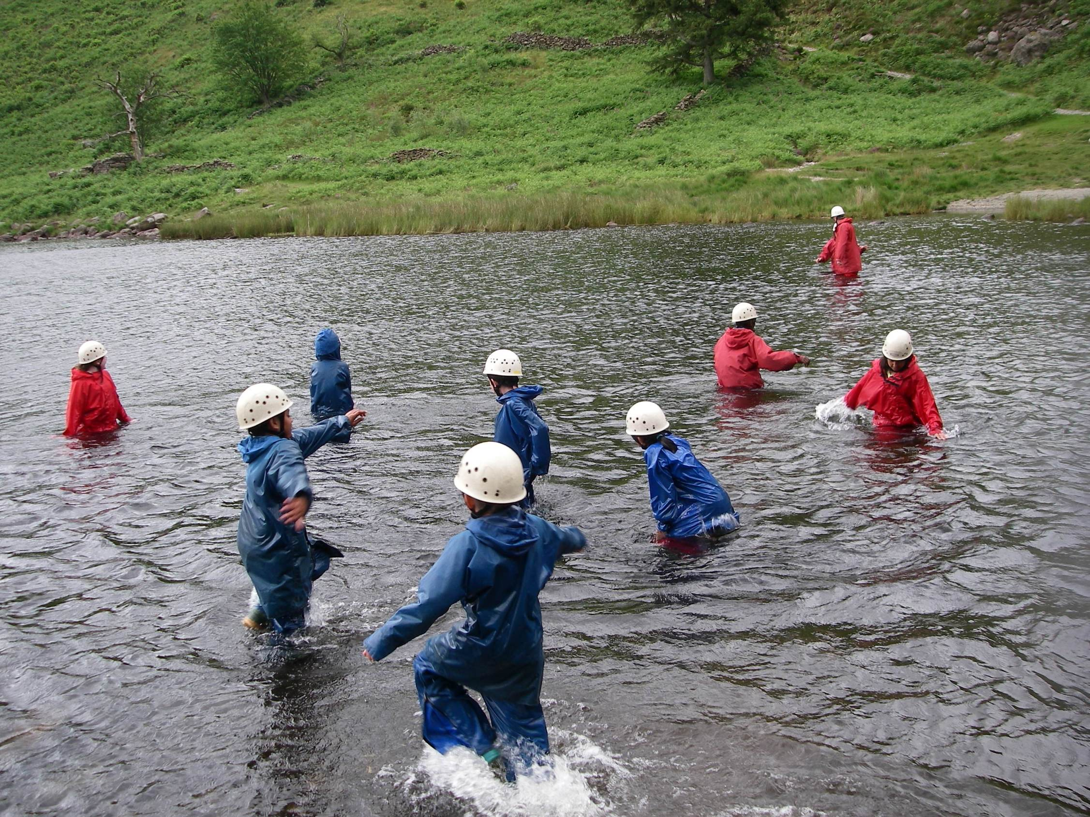

Slide 16
TRAVEL ARRANGEMENTS
  Children will be picked up from Holy Trinity
  Arrive at normal time - 8.35am
  Meet in the new hall
  Coach is loaded and leaves school at about 9am
  Journey time is approximately three and a half hours
  There will be a toilet stop half way at Llangollen.
  Children must bring a packed lunch for the first day.
  The children will have their lunch before the return journey leaves Plas Gwynant at around 11.30.
  They should arrive at Holy Trinity for around 3pm.
Notes:
Give details of Centres whereabouts, coach arrangements to and from the Centre, require packed lunch, in their own lunch box which they will use all week.

Slide 17
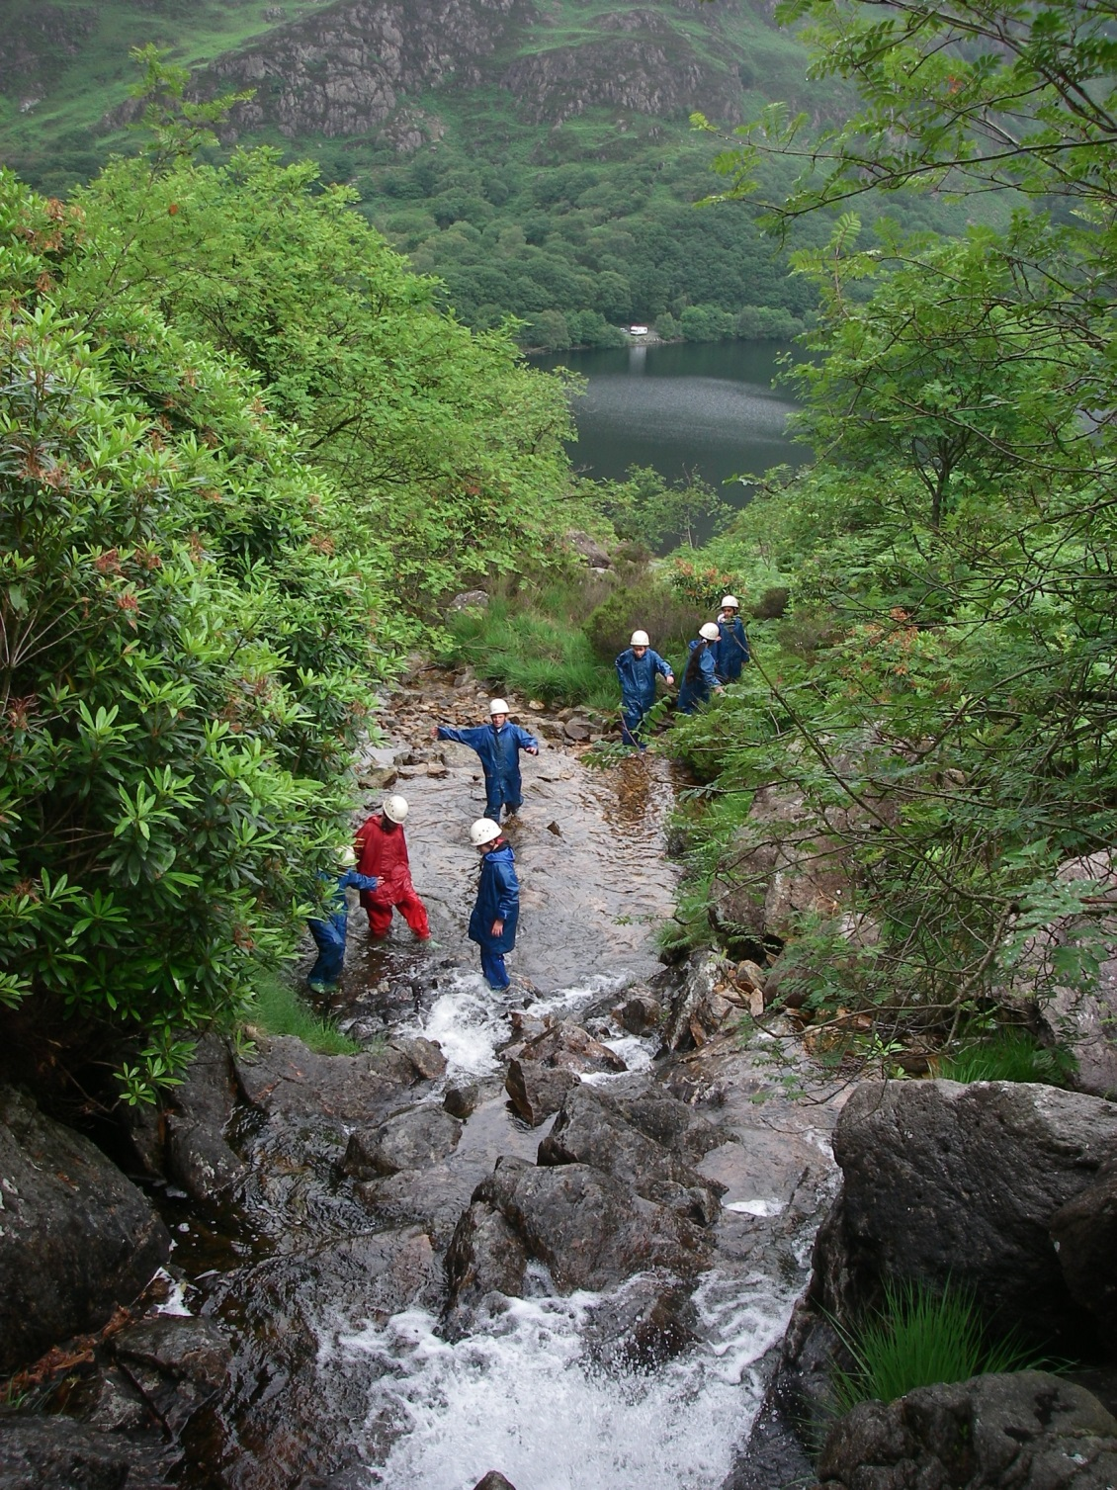

Slide 18
Pocket Money
There is a shop at Plas Gwynant which may open in the evening.
A variety of soft drinks, sweets and crisps are on sale
Students are encouraged to be responsible for their own pocket money and to decide their own spending choices.
Also on sale are disposable cameras, warm hats, gloves, socks, torches and batteries, pencils, pens etc, posters, postcards and a variety of small souvenirs.
Primary children often have the opportunity to visit the village of Beddgelert and buy gifts or ice-cream from the local shops
The amount of pocket money should not be excessive - £10 would be adequate.
Staff will not accept responsibility for money especially if it is lost.

Slide 19
Mobile Phones & Electronic devices
There is no mobile phone signal at Plas Gwynant so children will therefore not be allowed to take their phones with them as they won’t be able to use them.
Staff will update the school Facebook group and website, when time allows.
NO expensive electronic devices, e.g. Ipods, Ipads etc are allowed on the trip.

Slide 20
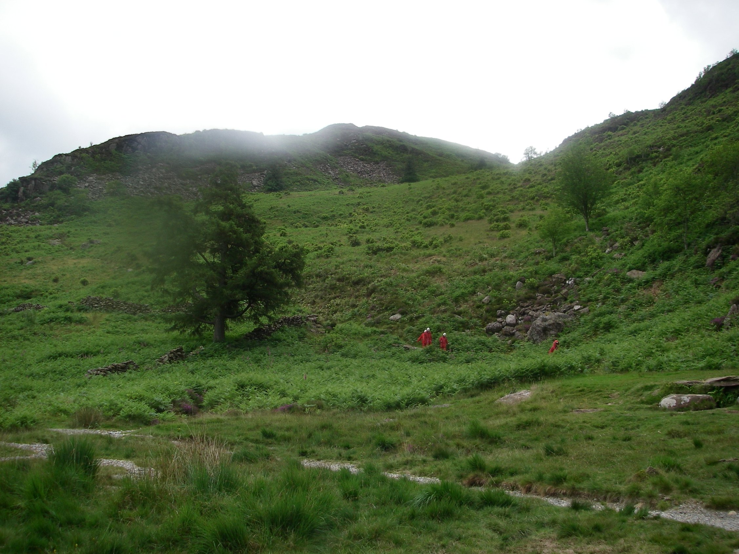

Slide 21
Rooms sleep four to six students in bunk beds with en suite facilities or there are bunkrooms for two with adjoining showers and toilets.
We provide all bedding - students only need to bring towels and their nighttime wear, e.g. pyjamas, slippers, bathrobes.
Students are expected to keep their rooms tidy and be responsible for their own possessions and Centre kit
Accommodation
Notes:
Explain about sleeping arrangements, bed times, space available, need to bring towels but all bedding provided - kit list will cover all the other things they should bring

Slide 22
GAMES ROOM
During free time students have access to the games room
Music player
Pool tables
Table football
Table tennis – 50p for a ball
Giant Jenga
Assorted board games
Also mini football field

Slide 23
Costs and Payments
The full cost for the trip this year was £270.00. This included the cost of the coach hire and the centre fees for Plas Gwynant.
Holy Trinity have subsidised the cost from sports premium and through continued fundraising so the total amount payable by parents per child is £100.00
A non – refundable deposit for the trip will be required to confirm interest in the trip.
Half of the payment must be made by end February 2024.
Payments can be made in installments using the Holy Trinity school gateway App.
The trip must be paid in full by Friday 12th July 2024

