Slide 1

Welcome Parents
Y5 Parents Meeting
Tuesday 9th September 2025

Slide 2
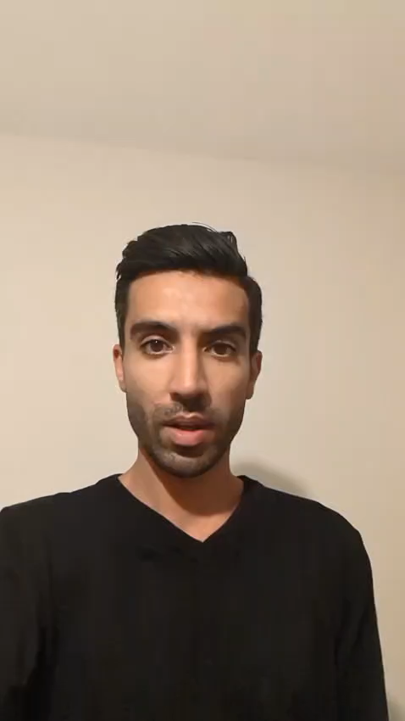
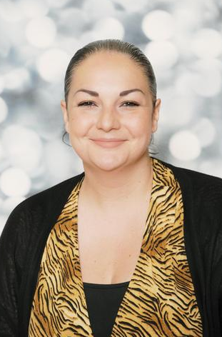
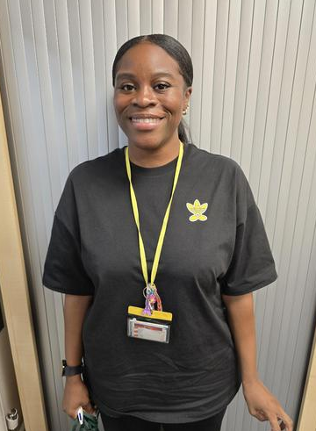
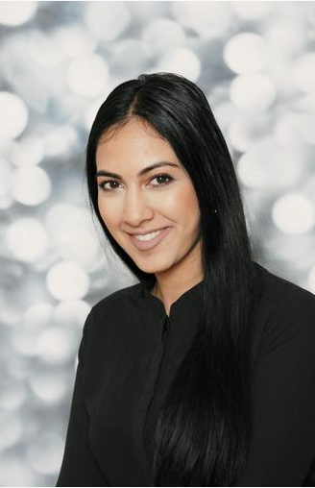
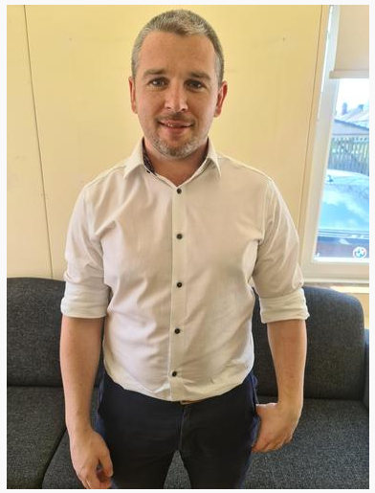
MEET THE TEACHERS
5C
5S
Miss. Lewis Class Teacher-
Tuesday, Wednesday and Thursday
Mr. Dhillon
Class Teacher
Monday and Friday
Miss Stevens
T & L Assistant
Miss Sokhi
Class Teacher
Mr.Taylor
Year 6 Teacher, Phase Leader Year4, 5 and 6
concerns- class teachers, phase leader, deputy and then Head

Slide 3
Welcome to Year 5
The School day
The curriculum
English, Maths
Science & Foundation Subjects
Reading – online
Homework
P.E
Uniform
Topics
Trips

Slide 4
Our School Day
8:35 - Gates open
As soon as children come in, there will be: a morning task waiting for them/ 1:1 sessions / closing gaps in learning / intervention groups/ readers
8:45am - Registration
10:20-10:25am- Brain Break
11:30-12:30pm -Lunch time 5C
11:45-12:45pm- Lunch time 5S
3:15pm - Home time

Slide 5
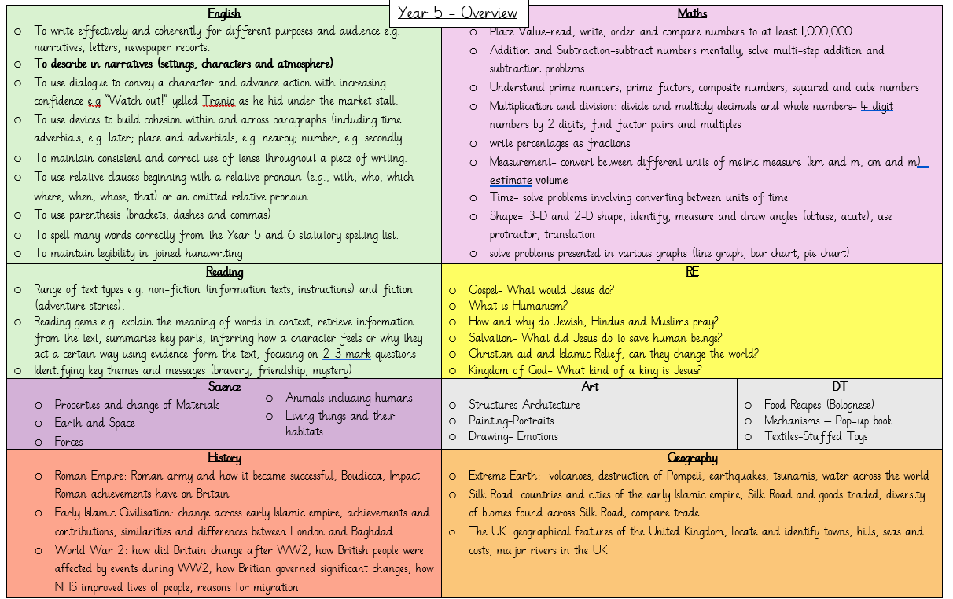

Slide 6
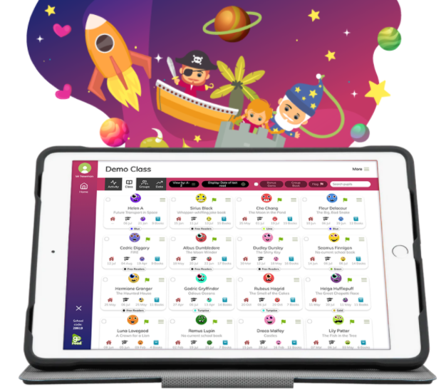

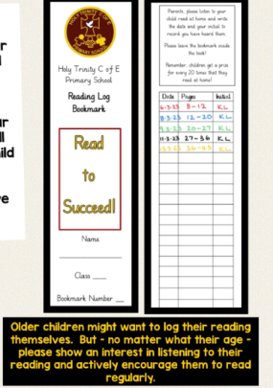
Reading
Expectations:
Children should be reading everyday. This doesn’t have to be just their reading books. Children can read library books, magazines and age-appropriate newspapers.
Parents need to go on the Boom Reader app to comment on their child’s reading at least once a week.
If you’re struggling to access any of the platforms, please speak to us.
We will be continuing to use ‘Go Read.’
It has been renamed ‘Boom Reader’ but it still fulfils the same purpose.

Slide 7


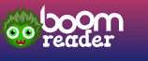

Homework
Children will be allocated a reading book, please encourage your children to read daily. You must record comments at least once a week boom reader.
Each week on a Friday children will be given spellings and they will have a spelling test the following Friday. Children will be expected to practice these spellings 3 times a week, not all in one day. These spellings will be taken from year 5 and 6 common exception words and statutory spelling rules.
Projects will be set each half term and submitted before the holidays. This will be based around learning in school.
Homework will be set on google classroom. This could be reading extracts before a lesson, a Maths video to help re-cap learning in school or extra interventions for some children.
Other online homework… Google Classroom

Slide 8

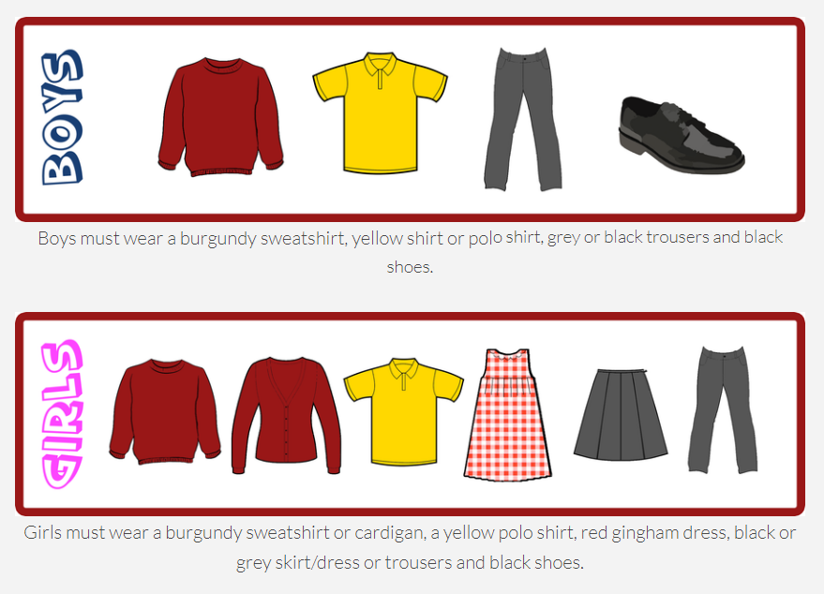
P.E Kit
Uniform
The PE kit should consist of a yellow polo shirt, school jumper, a pair of black shorts or jogging bottoms and a pair of black pumps or trainers
Both year 5 classes will have P.E on a Thursday

Slide 9
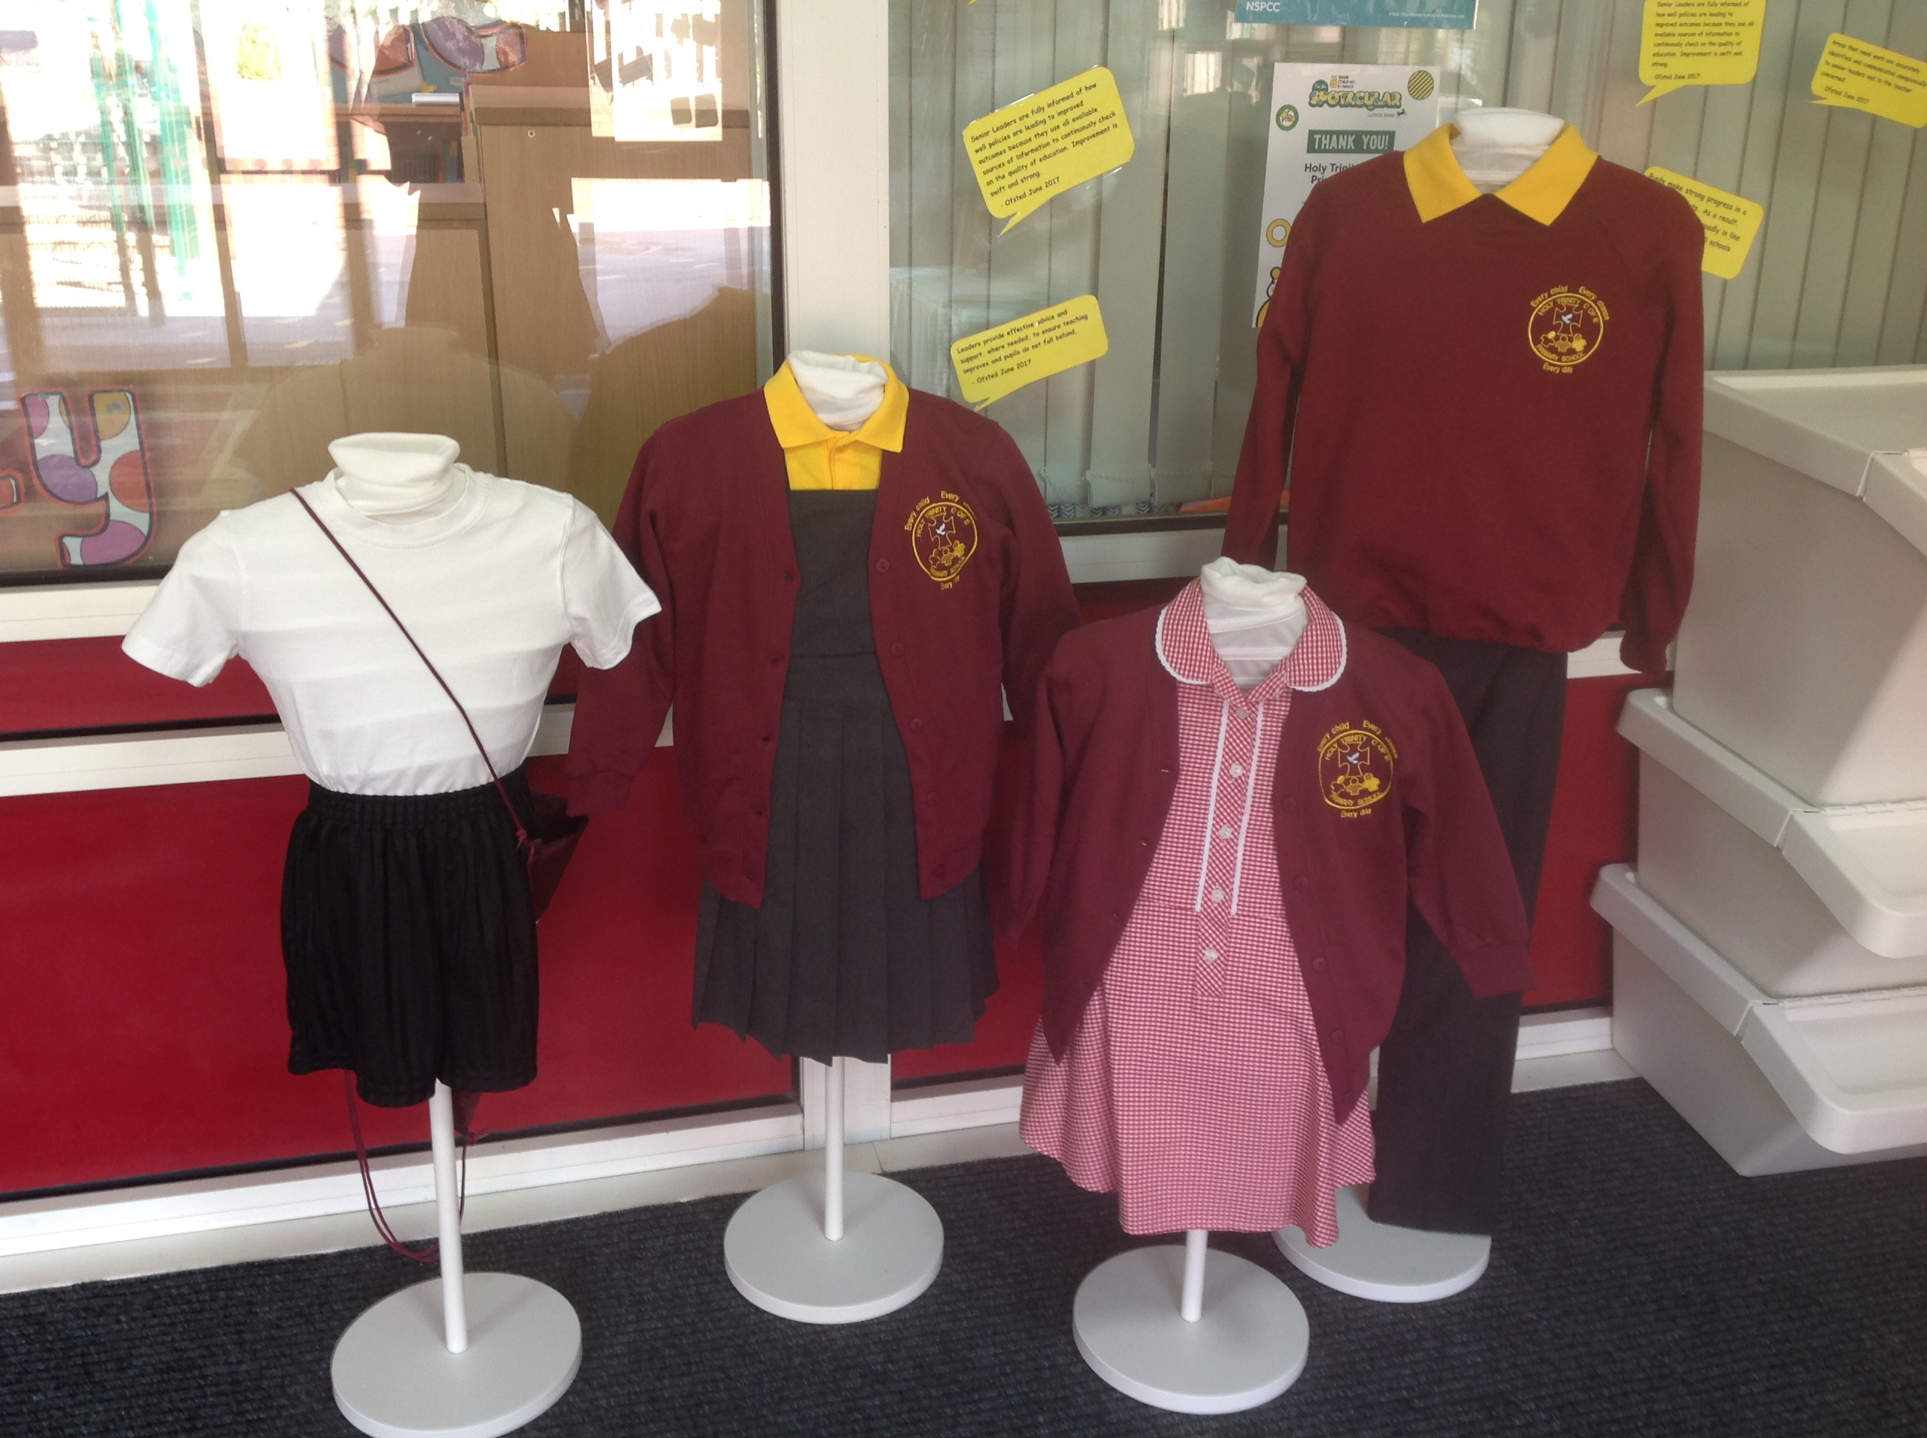

Slide 10
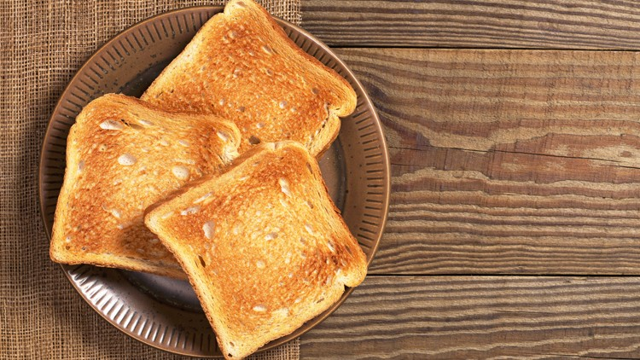
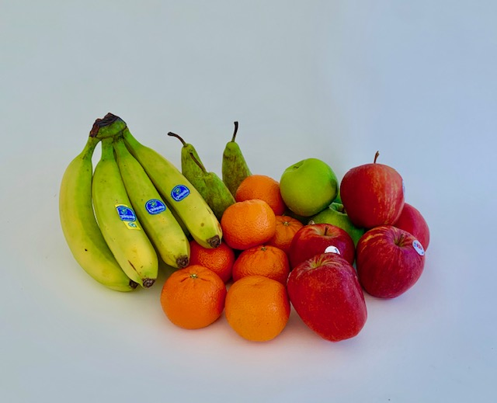
Toast
Break Time Snacks.
Children can bring a piece of fruit for their snack at playtime if they wish to (no chocolate/sweets please!)
Children are welcome to have toast each week at a cost of 50p however this needs to be paid online (Gateway). You will need to pay at the end of every half term for your child to have toast the following half term.
Children can also have milk at break times which also needs to be paid online.

Slide 11
Trips
Educational Visits- R.E visit to Mosque, Young Voices (February), Sandwell Valley RSPB Visit/Orienteering. Trips are likely to change throughout the year.

Slide 12
Good behaviour
We continue to follow the “Good to be Green” approach with our behaviour management.
Non-verbal warning
Verbal warning- blue stop and think card-
Yellow card (miss 5 minutes play)
Red card (miss 10 minutes play)
Behaviour recovery (Senior leaders office)
Praise Assembly
Praise Assembly will take place on Tuesday Morning. If your child has been selected for praise you will receive an invitation on the Friday before to join us in celebrating your child’s achievements at 8:50am. A polite reminder that photos are not permitted during performances/ activities
Halos
Children will receive halos for showing our learning behaviours. These can be then spent in our halo shop every half term.

Slide 13
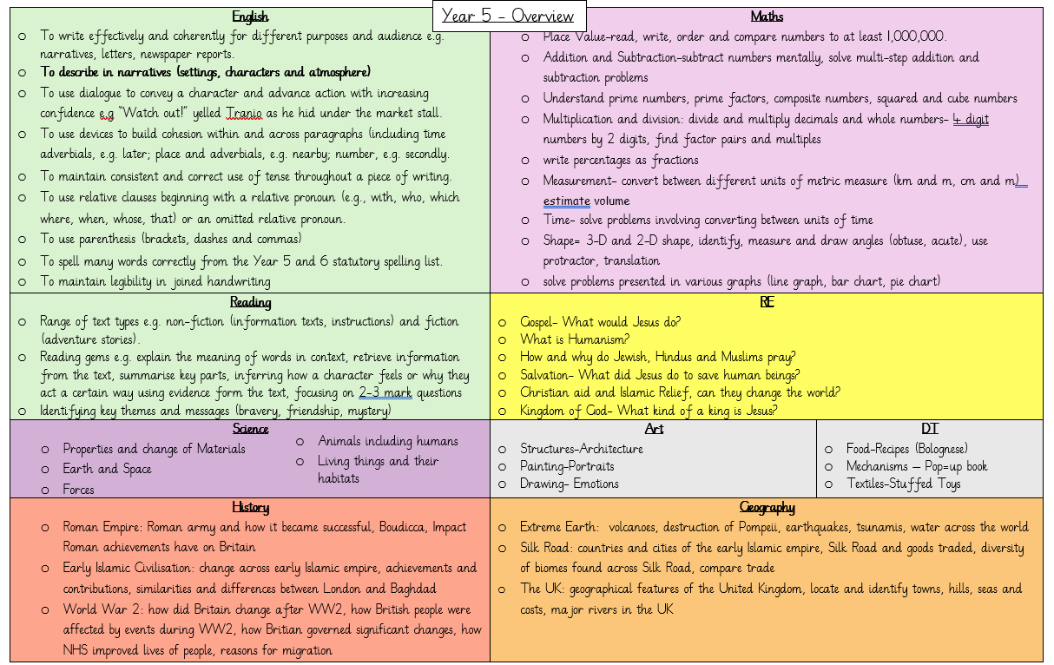
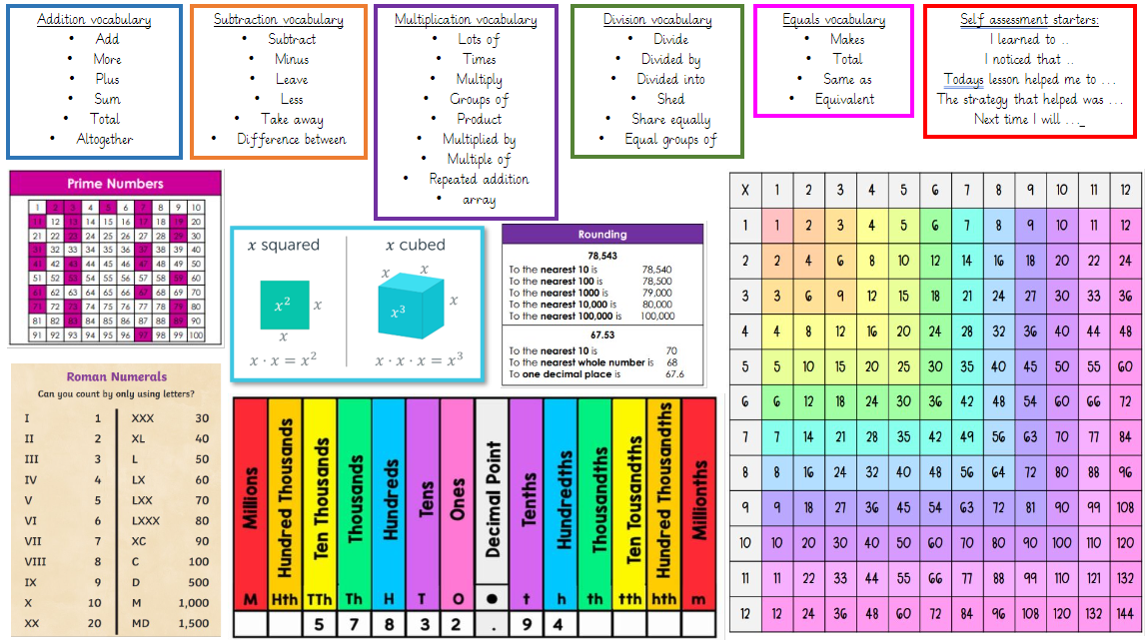
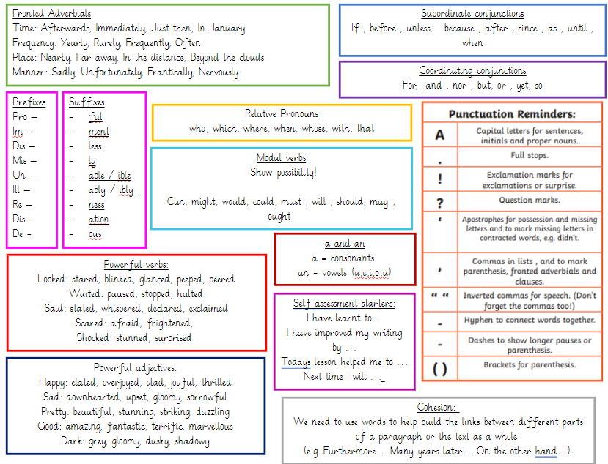
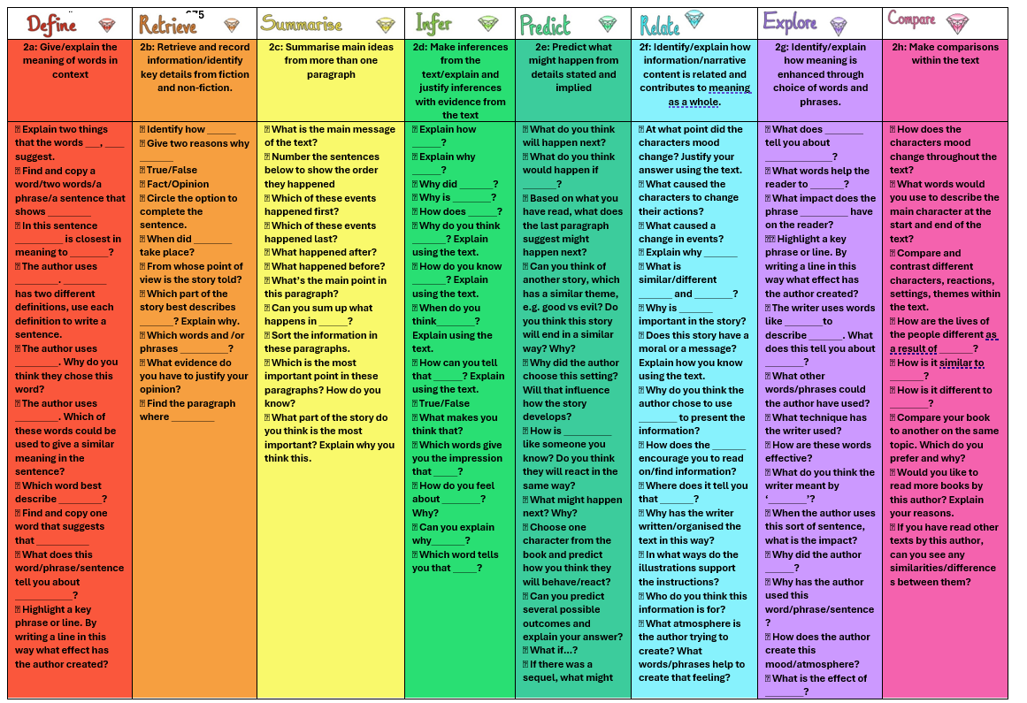
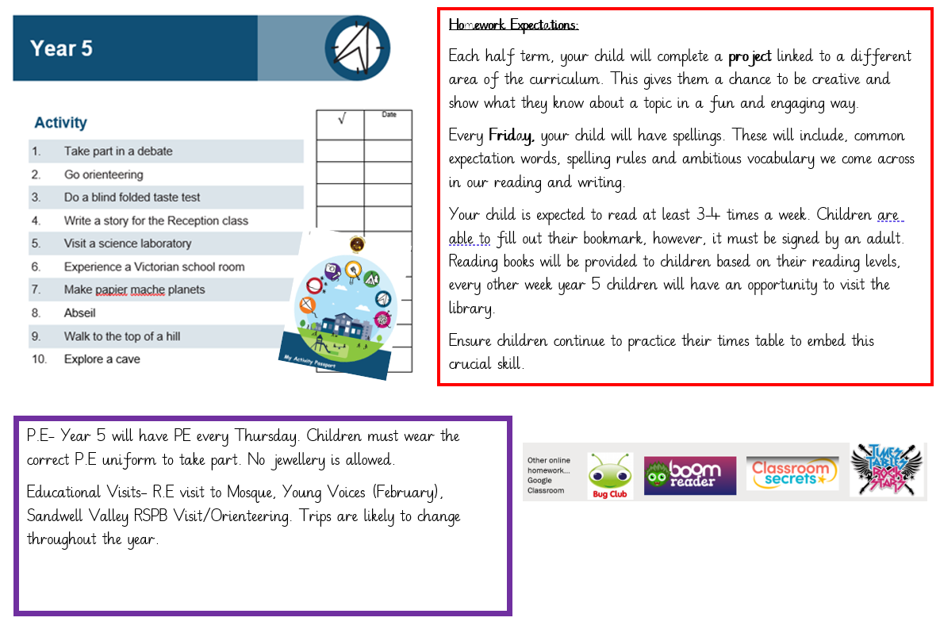
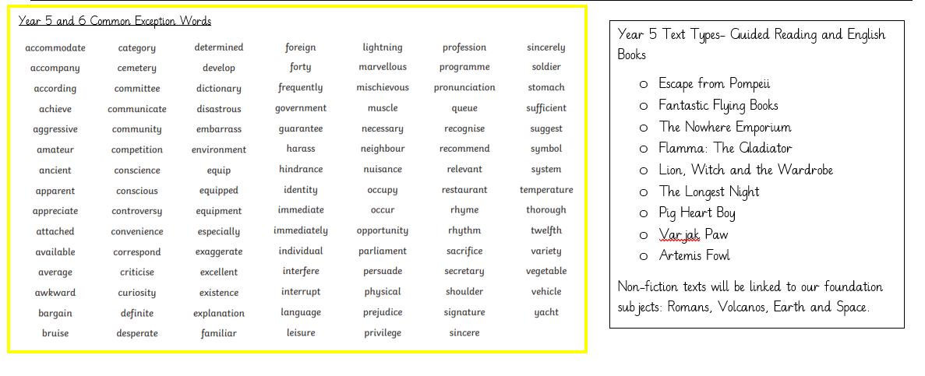
Learning pack- Each parent will receive a learning pack through an email.

Slide 14
What you can do to help at home?
Listen to your child read as this will be our main focus in year 5
Ensure that your child completes their homework
Practise spellings, times tables and sentence writing.
Ensure your child is in school everyday and on time.
Talk to your child about their learning.
Help to keep your child and others safe.

Slide 15
Questions?

